Slide 1
introduction.
Week 1 | Lecture 1 (1.1)

Slide 2
This Week’s Content
Lecture 1.1
Introduction
Lecture 1.2
Variables, Expressions, and Operators
Reading: Chapters 1, 2, 3
Lecture 1.3
The Programming Process

Slide 3
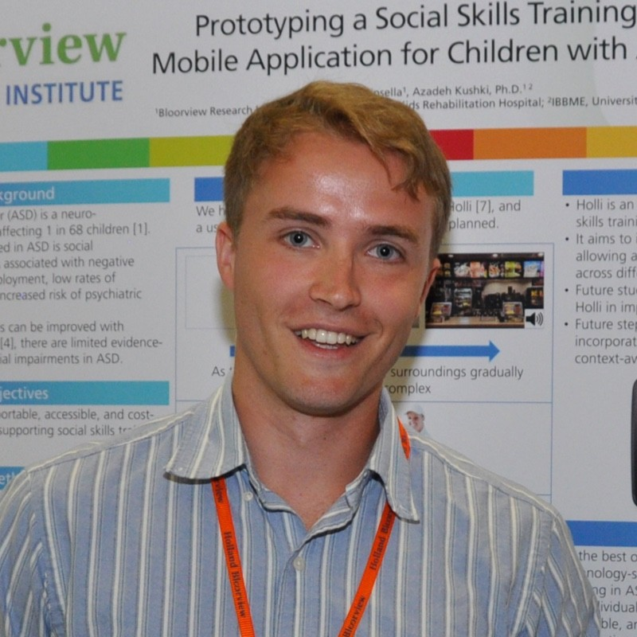

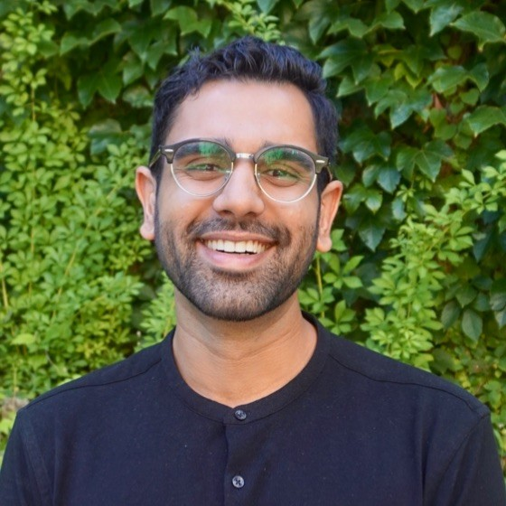
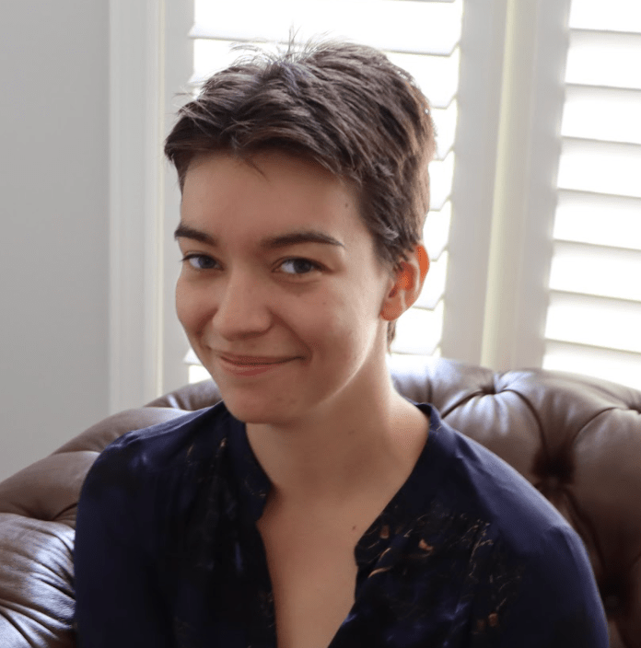
Teaching Team
Ben
Instructor
Seb
Instructor
Joseph
TA
Katia
TA
Notes:
I want to intro the team. We’ve got 2 TAs helping us lead this lecture slot, brilliant and experienced programmers doing a ton of programming for the PhD in different fields, but they’ll introduce themselves a bit later.

Slide 4
Ben
Bachelor of Electrical & Biomedical Engineering @ McMaster University 2015
Realized the power of programming (and how it can be used for good, not evil)
Master of Biomedical Engineering @ University of Toronto 2020
Hold up… people will pay me for ‘playing’ on my computer?
In between obtaining degrees I spent time programming a few different projects…
Notes:
Before coming to university, my only experience with programming – maybe don’t say – well I was a nerd in high school, on my computer a lot, and my big contribution to the world was writing viruses for my high school computers and to keep my high school IT department busy…
Roommate was in software engineering and video game engineering, all he did was make and play video games for 5 years.
Courses on the software and algorithms behind MRI and x-ray machines, got to program some ourselves.
From the teaching perspective, people doing a lot of amazing work developing software to predict student drop-outs, and more importantly, early flags that might let us intervene. For example one big flag at McMaster when I was there was the first calculus test in engineering, and if they got below a certain threshold, we could very accurately predict how what they’d get in other courses. If they did poorly and gave us that flag they might drop out, it allows the teaching team to intervene and get to you, give you extra help, before you get to the point of dropping out.
After graduating, I got a few random jobs developing software for people that know nothing about software, usually different departments or labs at hospitals, and I realized that I could actually get paid for just playing around on my computer, jamming to music. I remember talking to friends and family about how weird it is to get paid that much for something that takes barely any effort, and they had to remind me that programming was a skill that I had, not them. I was valuable because of this programming skill, so many people have problems to solve, that programming can solve, but they don’t know how to solve because they don’t know how to program.
This is something Seb, Katia, and Joseph really want to emphasize to you in this course, is how valuable you can be if you learn to program. And it does not matter what field you’re in either.
So to give you a couple examples of things I worked on before and during my Masters degree:

Slide 5
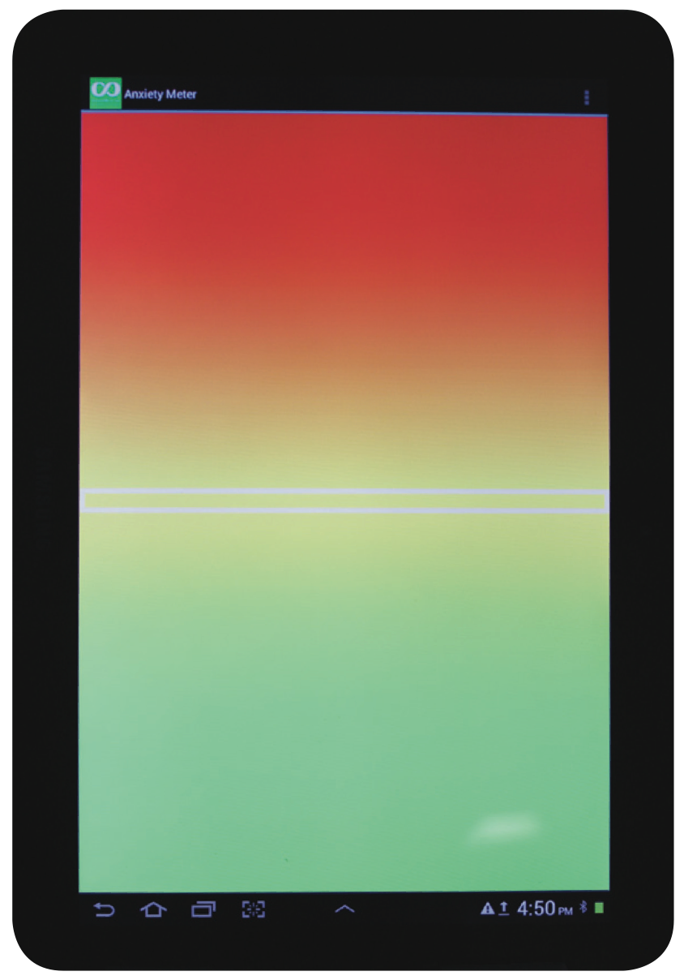


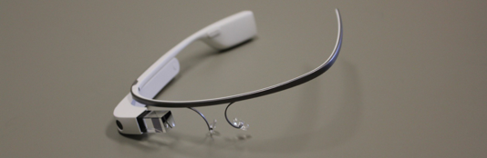

Projects for children with autism spectrum disorder
Hi!
Notes:
Project on the left is a screenshot from the “Anxiety Meter” I worked for a couple years in an Autism Research Centre, and I worked with over 20 psychologists, psychiatrists, and therapists, but no other engineers. They had all these ideas and problems to solve, and needed someone with skills, which I was still coming to terms with being a real skill.
So kids with autism spectrum disorder, can get anxious very easily, so they are trained, by the therapists and psychologists to manage their anxiety. One thing they aren’t particularly good at, perhaps like a lot of us, is KNOWING when we’re anxious. We’ve all heard deep breathing can help with anxiety, but how often do we actually practice that throughout a stressful day? The anxiety meter was used to convert skin conductance, measured by 3 electrodes we’d stick on the body, that could measure how much you sweat and calibrate that and convert that to an anxiety measure. The white line in the middle would move up and down based on your anxiety, red being high anxiety, and it would show us, or our children with ASD, that they are getting anxious, so they can practice their calming or breathing techniques and relax before having an outburst.
My biggest project working with them, was an artificially intelligent social coach. This kids we worked with we’re brilliant, some had super high IQs, but one of the core deficits that comes with ASD is the ability to communicate. They know what they want to say, they just don’t communicate in the same way you or I would naturally. So I programmed an app for the Google Glass, which has the lens with a screen, as well as a microphone to listen to what’s being said in the environment. The goal was to listen to what’s being said, and prompt the user, or child with ASD, with appropriate social responses. If someone said Hi, it could prompt them with appropriate greets to say back. If someone said “May I take your order?” and your GPS said you were in a McDonald’s, it might give options like “I would like a Big Mac please” and “I would like a large fries, thank you”.
Using these with real children, the results were amazing. Without the glasses, the children would very rarely respond or in a very limited way. Yes and No. Using the glasses, I was able to have full conversations with them, and their parents got super emotional seeing them talk like that”. So the power of programming can really change lives.

Slide 6
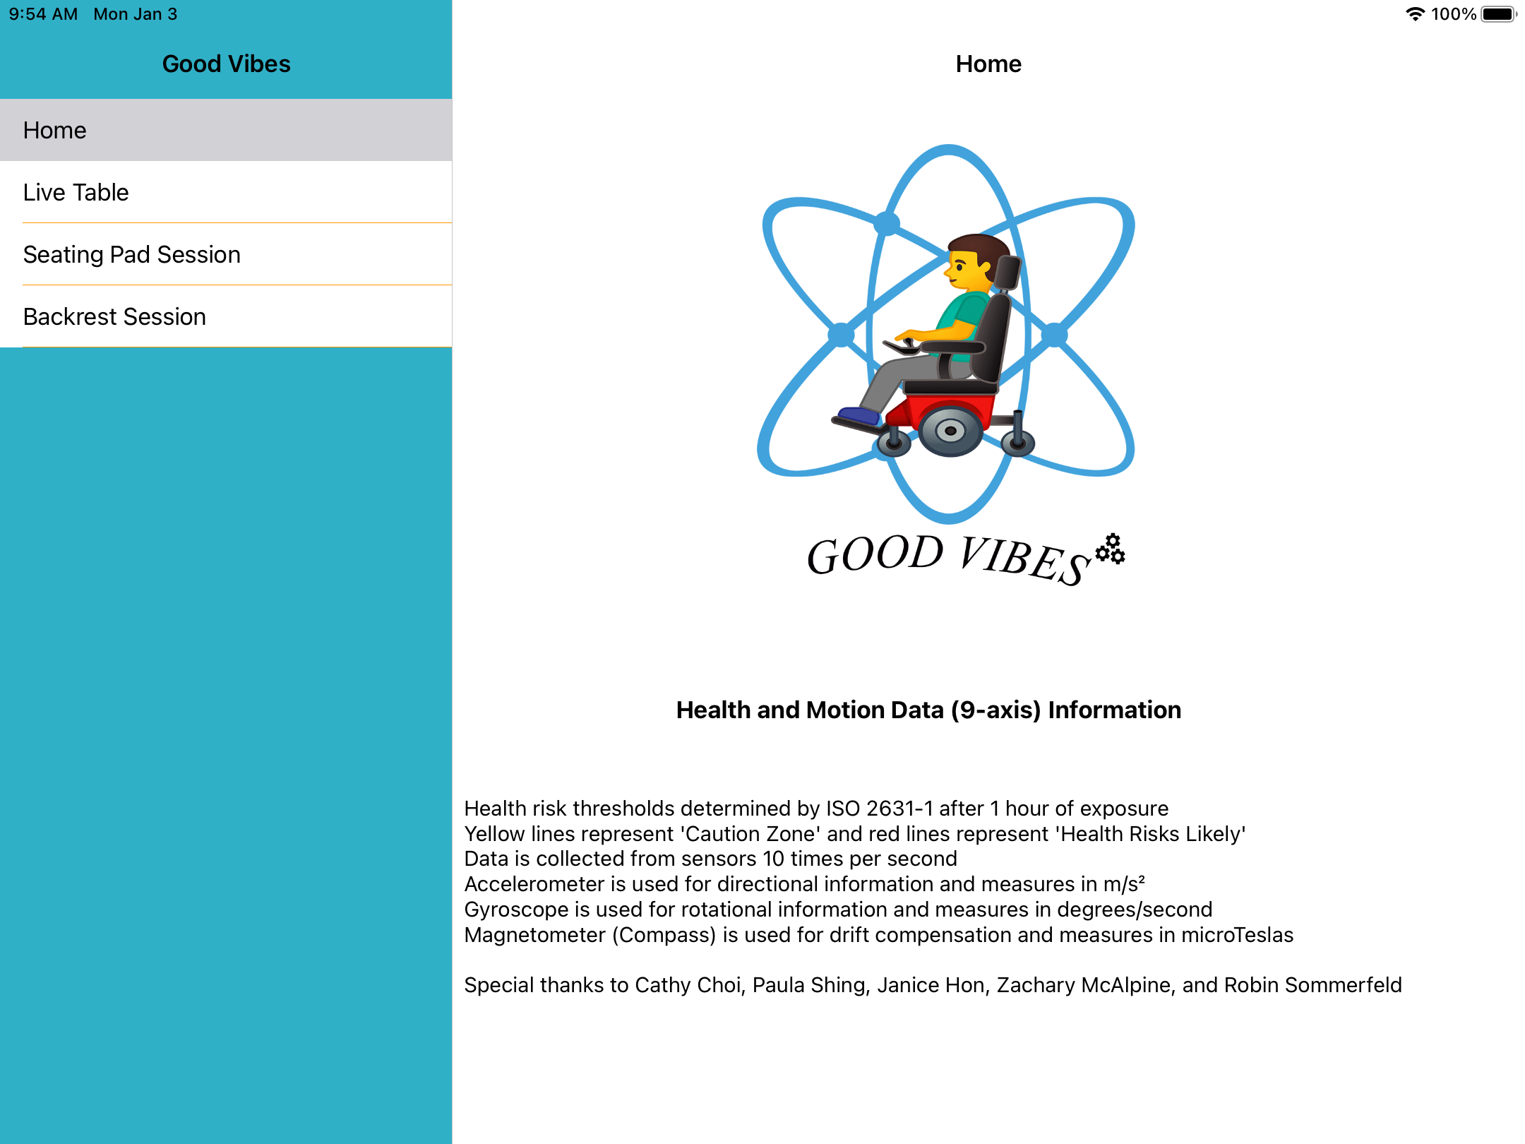
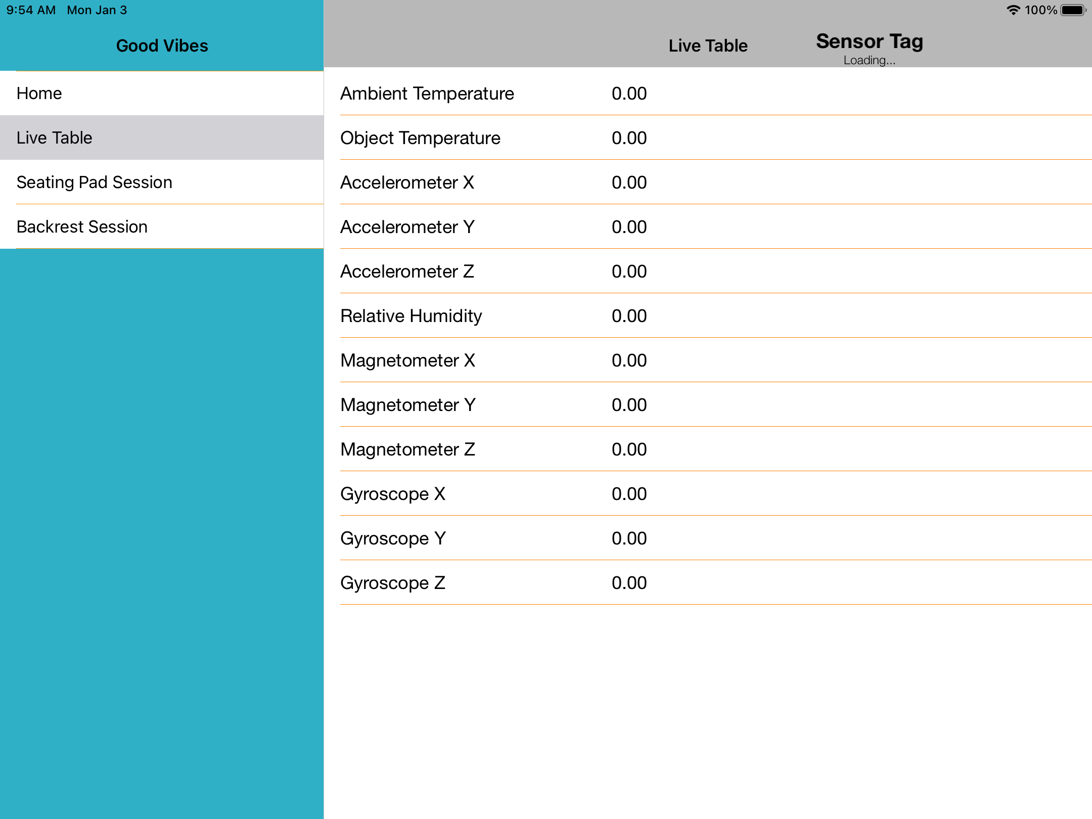
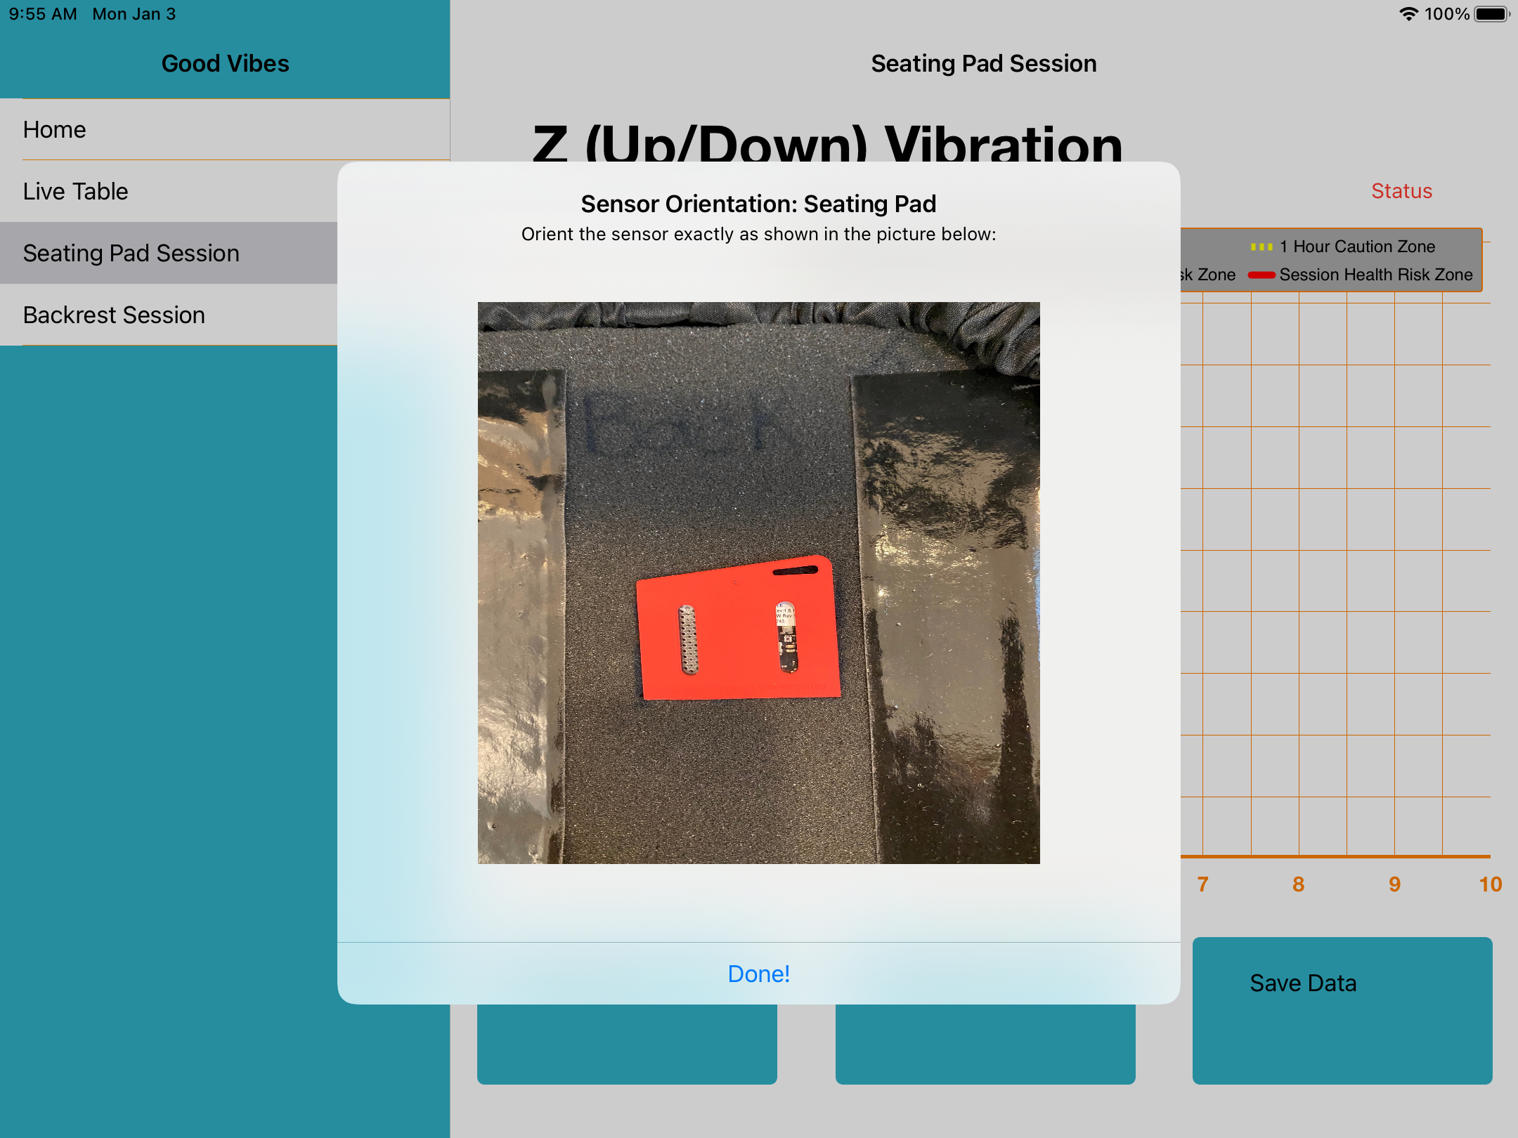
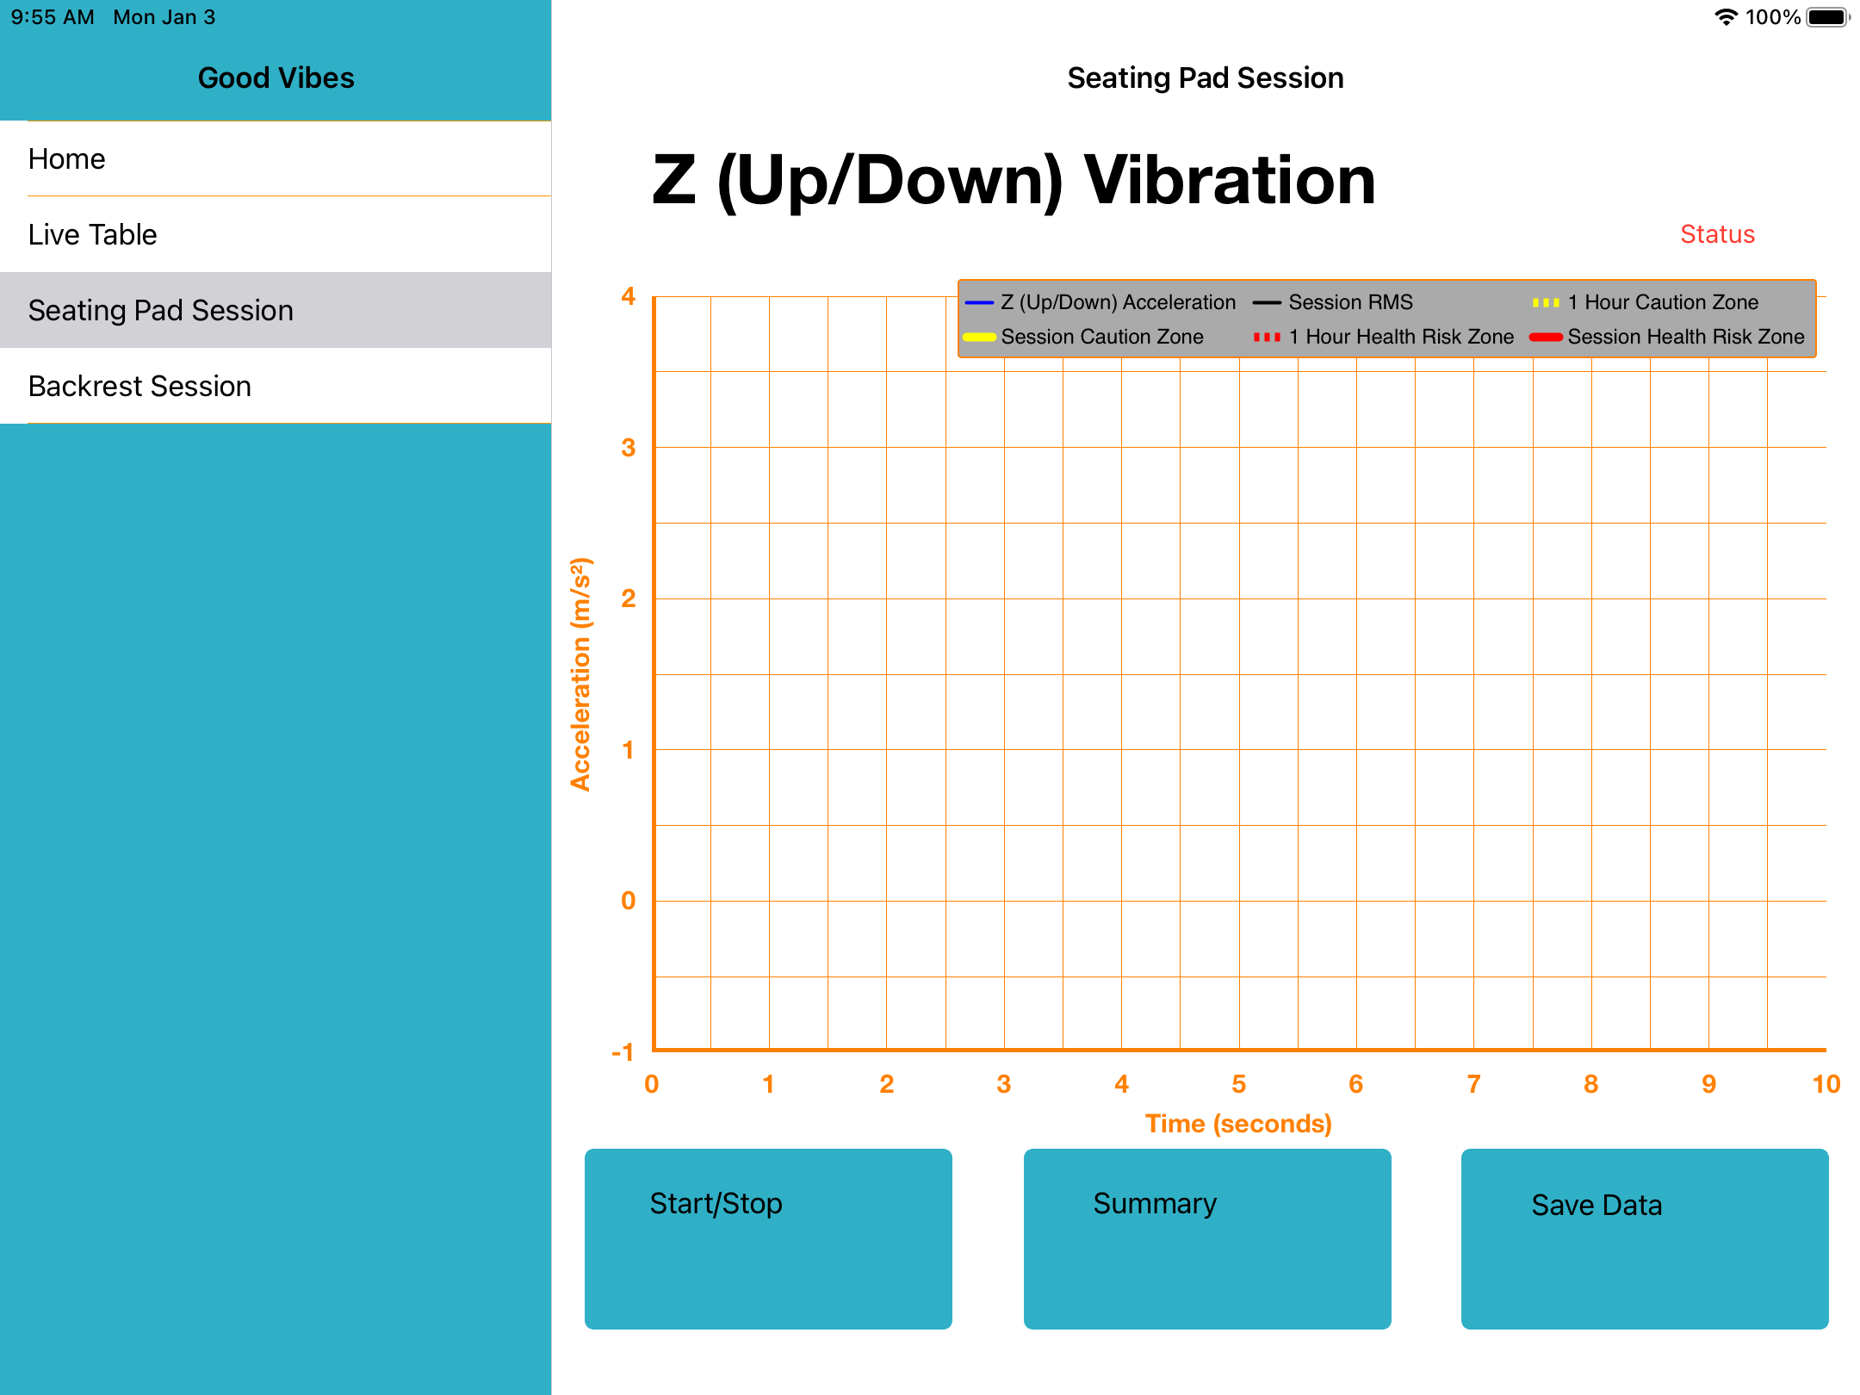


Good Vibes A wheelchair vibration measurement tool
Notes:
Another project I built that I thought you might find interesting, is a tool for measuring vibration in a wheelchair. There’s a lot of research that shows how long-term vibration of riding on wheelchairs can be very traumatic and damaging for users joints, specifically their spines. However, there was not one single tool available to measure wheelchair vibration, so we can compare how different wheelchairs, and how different types of cushions, can mitigate. Working out of a different Toronto hospital, I worked with occupational therapists, the people who help pick out appropriate wheelchairs and cushions for patients coming in, to build an app that lets them measure the amount of vibration (you can see the red sensor on the bottom left). Then based on each unique body shape for each patient, they can measure and quantitatively recommend the best cushion and wheelchair for each patient.

Slide 7
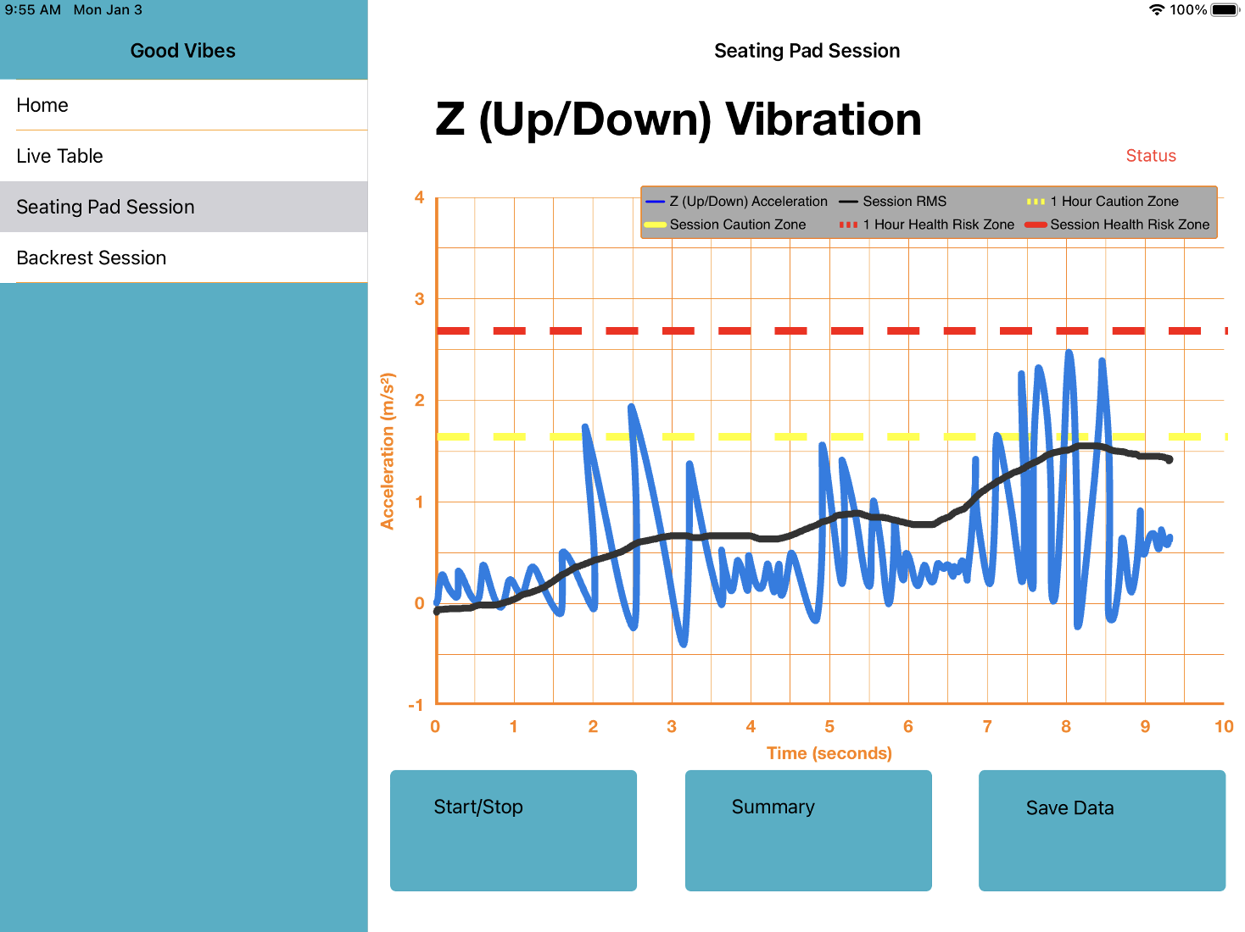
Notes:
Here you can see an example (I’ve drawn in the graph because I couldn’t grab a good screenshot). Blue line represents live up and down vibration, for example probably going over small bumps in the sidewalk. The black line is the average, which is what needs to stay below the yellow (caution zone) and red line (hazard zone) for safety.

Slide 8

More about Ben…
Notes:
Definitely not a digital artist, but I am a nerd so I do basically everything on the computer.
Bottom left you can see a super detailed, almost true-to-life, drawing of a hot pepper plant, which I grow myself because I love hot spicy foods, the spiciest that exist in the world. I found the super hot peppers, like Carolina reapers, are really hard to find and buy in Canada, so I grow them myself.
I love sports, on the right you see a baseball, when I was your age, the summer before university and the summer after first year university, I played baseball for Team Ontario and Team Canada. You can also see I’m unforutantely a fan of the Leafs. If you’re new to Toronto, you’ll soon realize how tragic being a Leafs fan is.
I also love music, I played piano and the drums growing up, and I love listening to country music.
I also have a fat orange cat named Catonio Banderas, you’ll probably see him walk in front of the camera at some point because he gets jealous when I’m talking to someone other than him.
I also love comics, and I go to Disney once a year, and since Disney bought marvel I figure that can represent both of those.
So if you want to talk comics, sports, music, hot foods, anything in the few minutes before lecture, I’m always game.

Slide 9



Seb
Completed CivMin PhD in 2014 where I studies rock fracture and seismology (RFDF).
AI Lead at KORE Geosystems, a mining tech startup.
Senior Research Scientist at SickKids.
Joined UofT CivMin in January 2020.
Research topics: rock mechanics, ultrasonics, signal processing, computer vision, applied machine learning in mining.

Slide 10

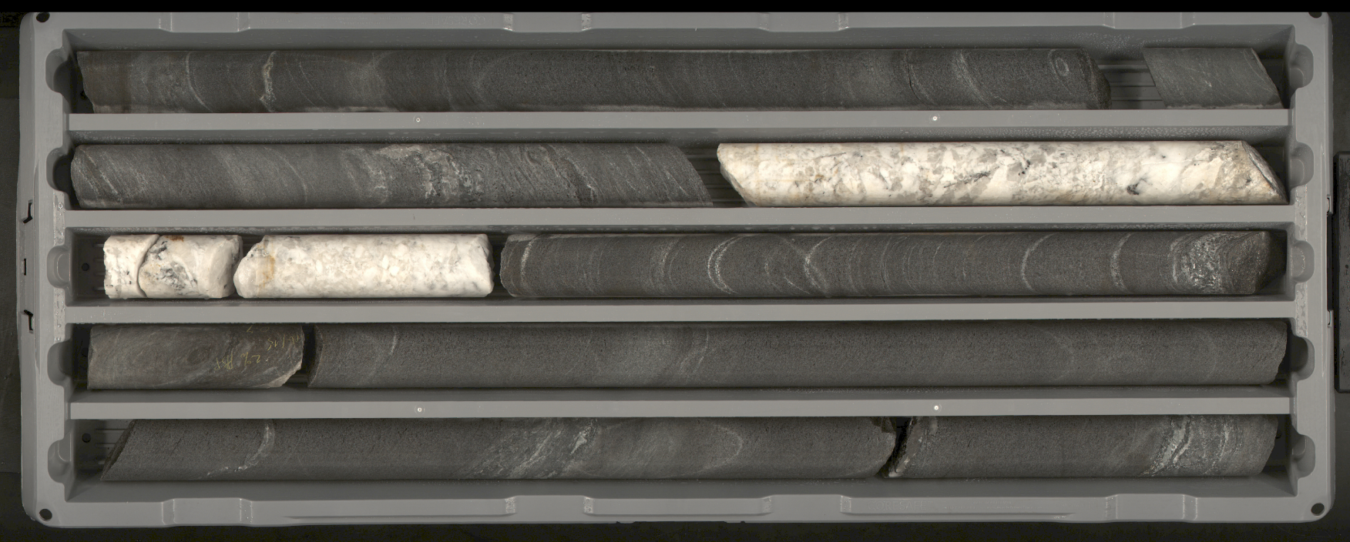
AI 4 Mining
At KORE,
I use code to do this!
Mining companies drill thousands of meters every year and the recovered rock (core) needs to be visually described by humans.

Slide 11
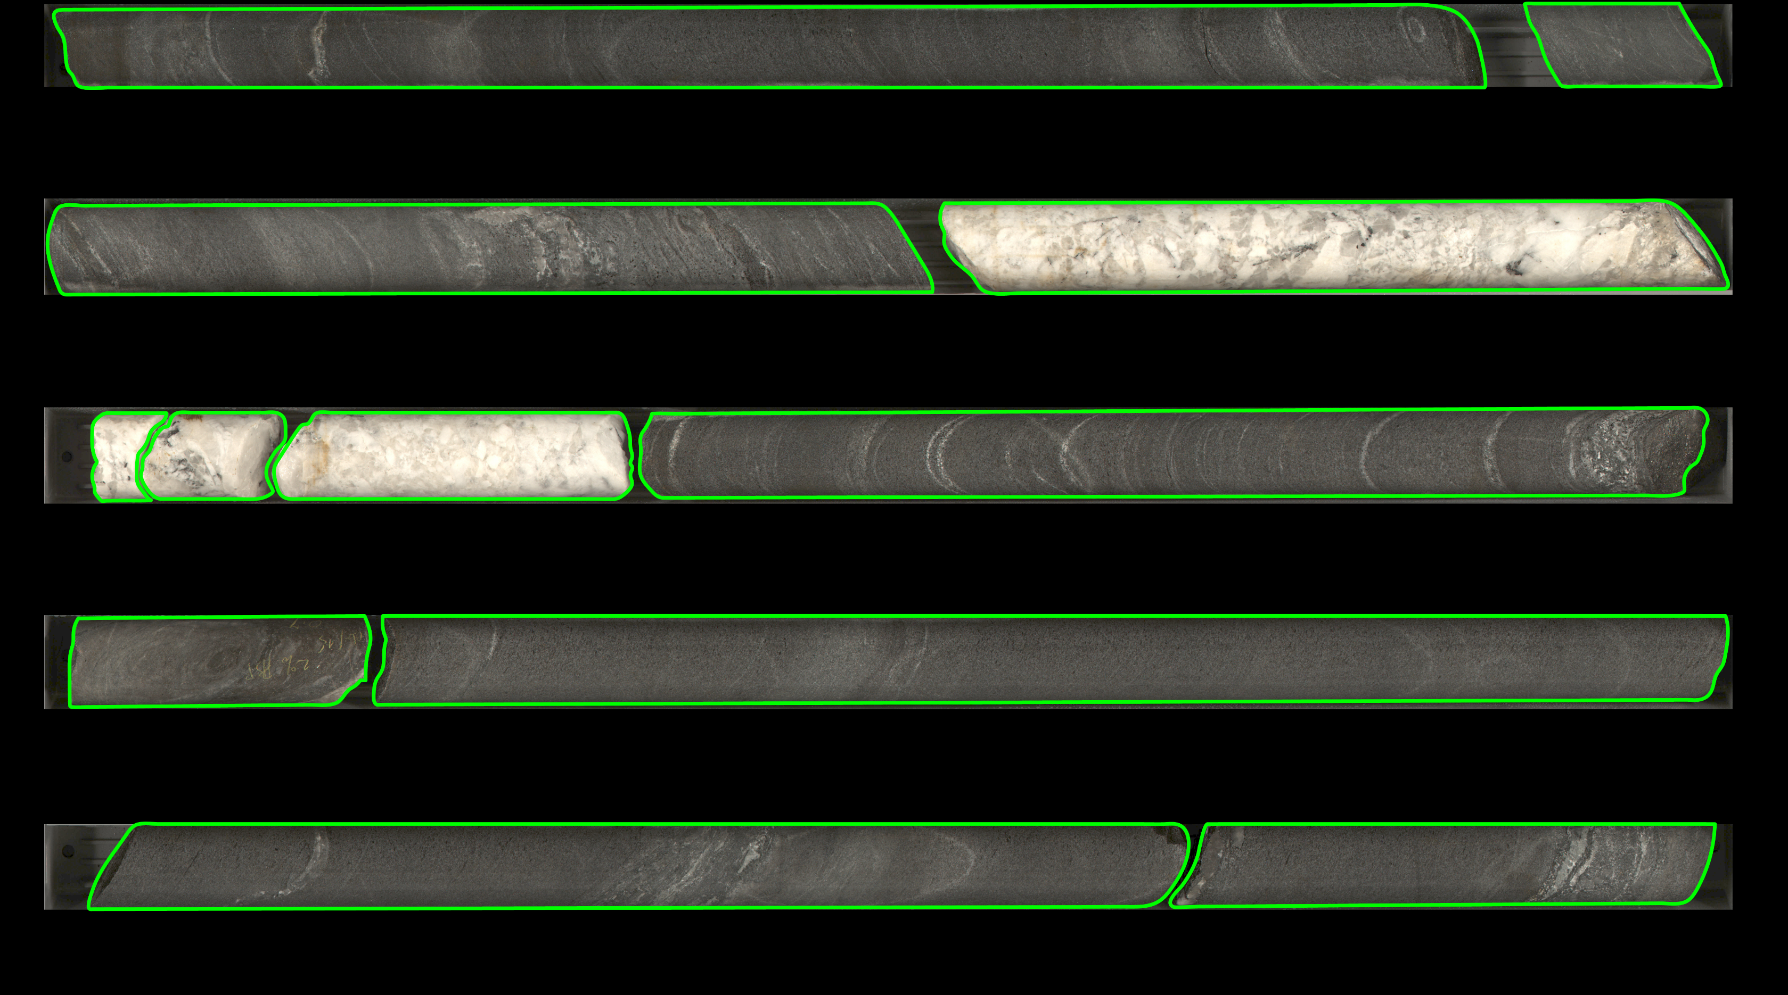
AI 4 Mining
At KORE,
I use code to do this!

Slide 12
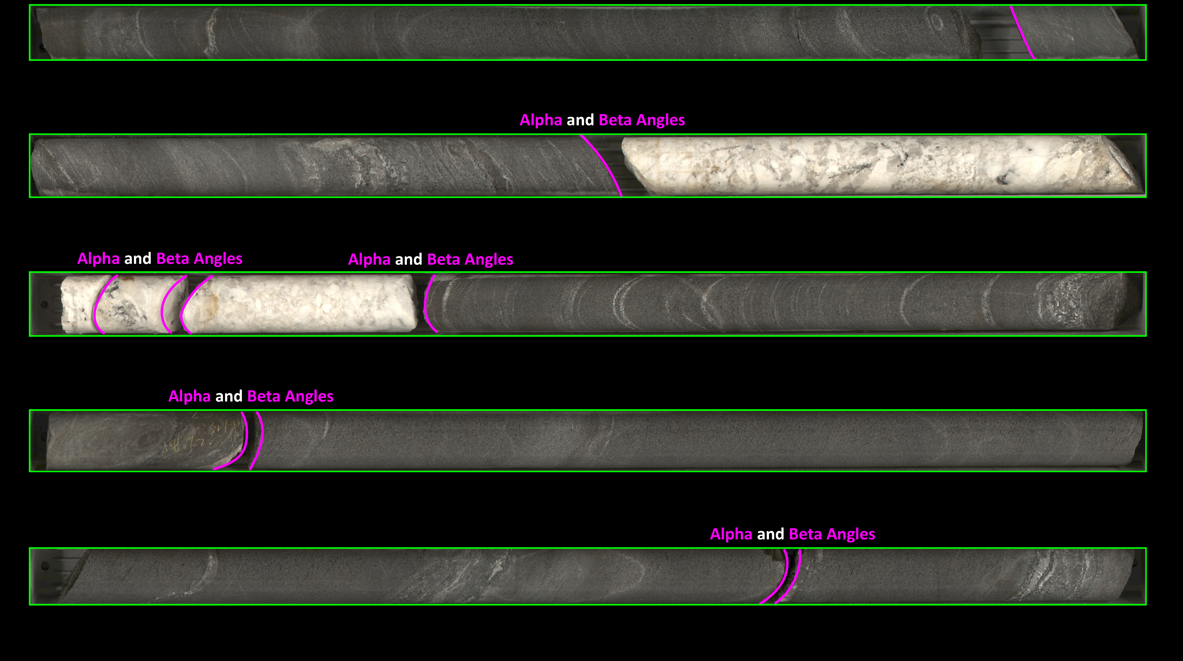
AI 4 Mining
At KORE,
I use code to do this!

Slide 13
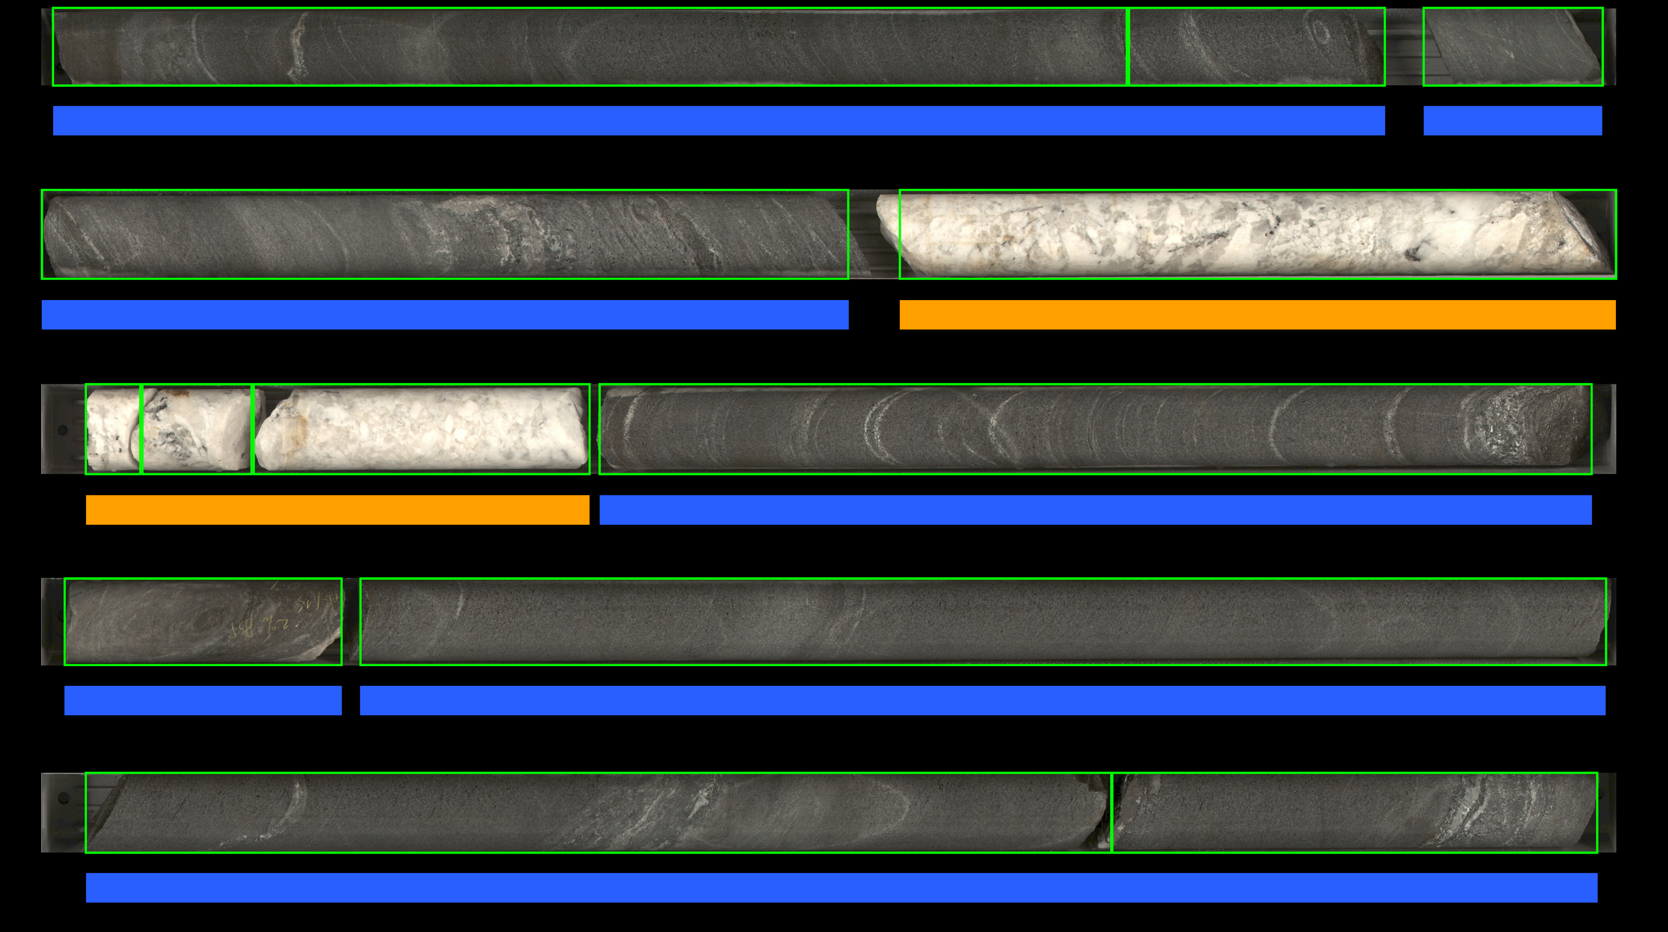
AI 4 Mining
At KORE,
I use code to do this!

Slide 14



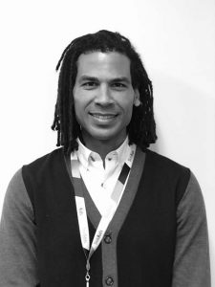


AI 4 Healthcare
AI Diagnosis
JET 98%
AI
Detects
JET
Pages
Mjaye
At SickKids,
I use code to do this!
Staff Physician
Nurse
Confirm
12-Lead
JET
Onset
5 minutes later
Treatment begins
AI

Slide 15

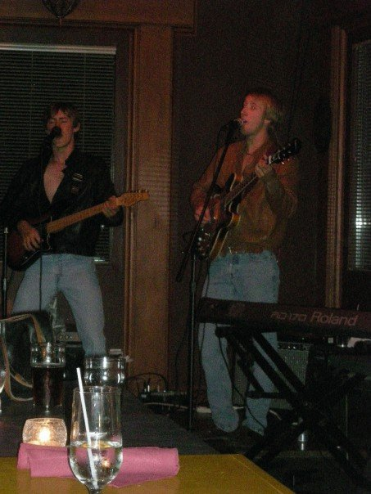
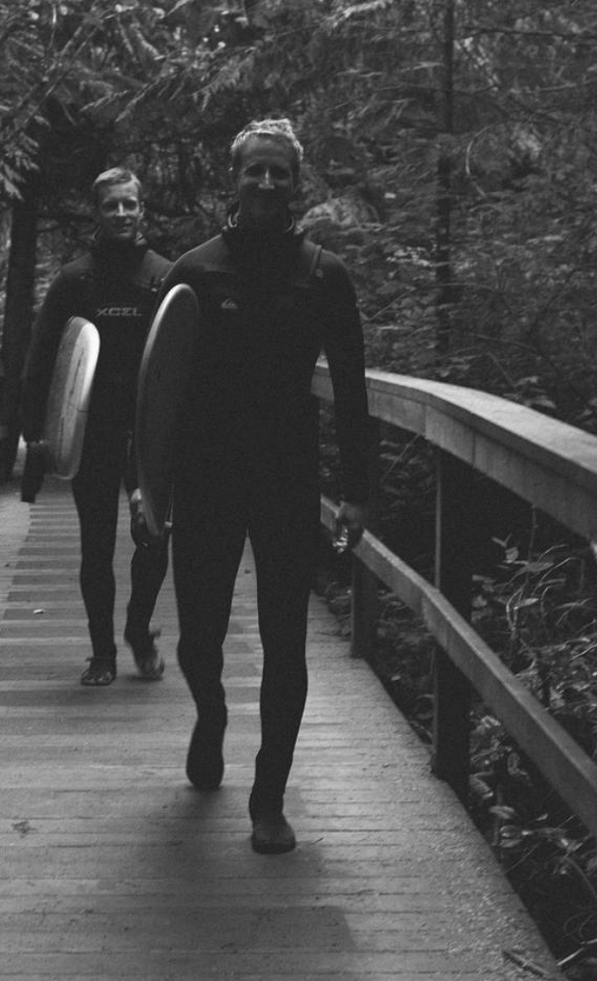



Seb
I love travelling and have visited over 20 countries including France, Switzerland, Italy, Austria, Croatia, Costa Rica, Nicaragua, Panama, Peru, Bolivia, United States, Israel, Jordan, West Bank, Egypt, Turkey, Morocco, South Africa, and Namibia.
I was a founding member of Ottawa’s premiere Beatles cover band.
I love camping, hiking, and surfing.
I have a wonderful baby boy named Avery Goodfellow and baby girl name August.
I love building things with code ( Github: Seb-Good).

Slide 16
Katia
Doing a Master's in Civil Engineering.​
Worked as a software application engineer-in-training (EIT) for 3.5 years.​
Working with Python to analyze and clean data!
Using Python to work with images from digital and optical microscopes of concrete and other building materials. As well, analyzing fracture behavior from Finite Discrete Element simulation models (FDEM).​
Martial arts fanatic :) involved in both Muay Thai and karate. ​
Also play piano, working towards Royal Conservatory certification.

Slide 17
Joseph
Doing a PhD in biomedical engineering.
A marathon runner and currently training for a triathlon.
Interweaves Python and MATLAB to analyze ultrasound wave propagation in artificial hearts made from stem cells through image and signal analysis.

Slide 18

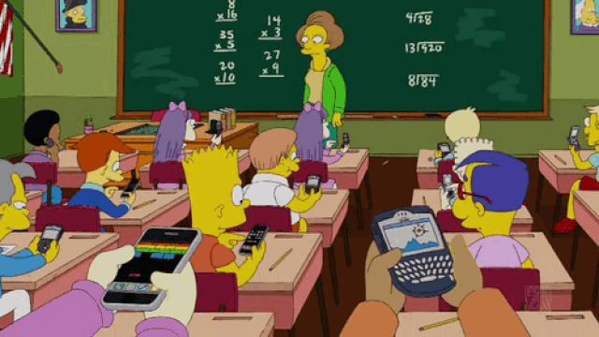
In Person (hopefully ☹)
Talking
Cell Phones
Eating
Being Late for Lectures

Slide 19


In Person (hopefully ☹)
Talking
Cell Phones
Eating
Being Late for Lectures

Slide 20
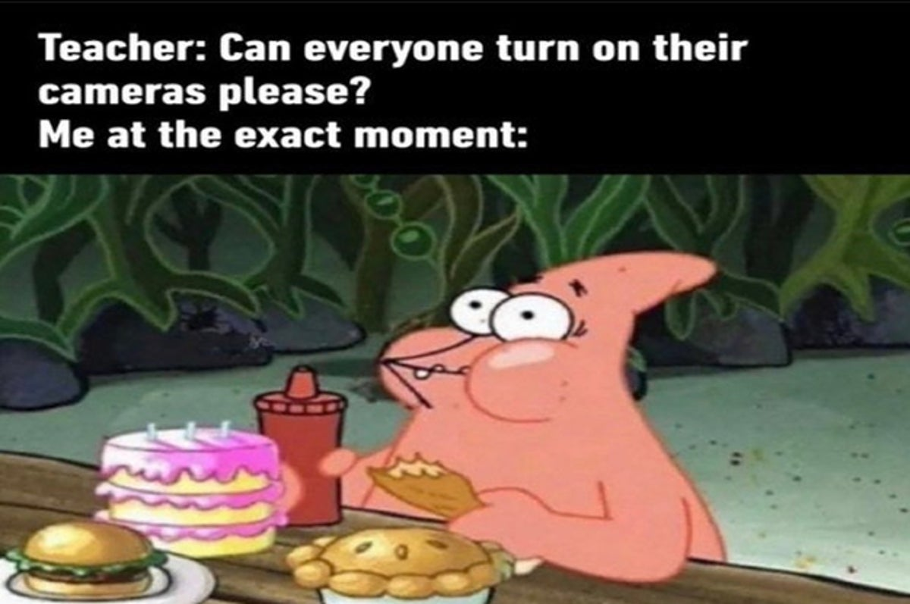
Online
Ask questions in the chat or raise your hand if you’d like to unmute yourself to ask a question.
Answer other students’ questions if you think you know the answer
Never forget - if you have a question, there’s always other people in the room wondering the same thing. They will be happy you asked it!

Slide 21
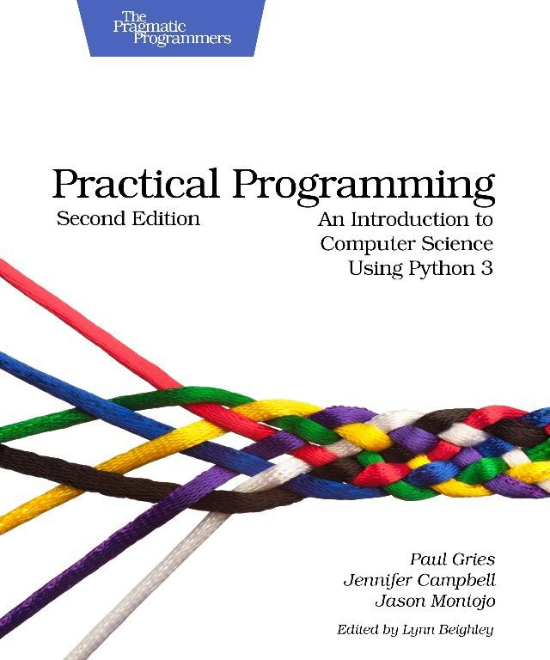
Course Information
Quercus:
APS106H1 S LEC0101 (One site contains all information).
Textbook:
Practical Programming: An Introduction to Computer Science Using Python 3, 2nd edition, Paul Gries, Jennifer Campbell, Jason Montojo, Pragmatic Programmers.
Piazza:
piazza.com/utoronto.ca/winter2019/aps106
Print $38 (e-book $25)

Slide 22
Grading
Labs (9 in total)
Midterm Test (s)
Final Exam
total: 10%
total: 40%
total: 50%
Petitions: First-year Office.

Slide 23
Lecture Schedule
Section | Monday | Tuesday | Wednesday | Thursday | Friday
LEC01 & LEC02 |  | 15:00-16:00 |  | 15:00-16:00 | 15:00-16:00
Lectures will be online until Jan 31 when we will (hopefully) transition to in person in MYHAL 150.
Microsoft Teams links for lectures can be found on Quercus.
Lecture content can be found on Quercus using the Kinsella & Goodfellow link.

Slide 24
Tutorial Schedule
Tutorials will be online until Jan 31 when we will (hopefully) transition to in person.
Zoom links for tutorials can be found on Quercus.
Week | Tut Content | Monday | Tuesday | Wednesday | Thursday | Friday
Week 1 (Jan 10 - Jan 14) | No Tutorial
Week 2 (Jan 17 - Jan 21) | Tutorial 1 | TUT0104 11:00-12:00 MY 380 | TUT0106 10:00-11:00 WB 130 TUT0107 11:00-12:00 GB 303 TUT0108 15:00-16:00 SS 1087 | TUT0102 12:00-13:00 MY 380 TUT0105 16:00-17:00 MY 380 |  | TUT0101 09:00-10:00 GB 304 TUT0103 13:00-14:00 WB 130
Click here for content.
Notes:
Tutorials online, optional, but very helpful. Programming is like a language.

Slide 25
Lab Schedule
Labs will be online until Jan 31 when we will (hopefully) transition to in person.
Zoom links for labs can be found on Quercus.
Week | Lab Content | Monday | Tuesday | Wednesday | Thursday | Friday
Week 1 (Jan 10 - Jan 14) | No Lab |  |  | Lab 1 Released 18:00
Week 2 (Jan 17 - Jan 21) | Lab 1 | PR0106 09:00-11:00 MY 030 PR0108 09:00-11:00 GB 144 | PR0107 09:00-11:00 MY 030 PR0102 16:00-18:00 GB 144 | PR0104 09:00-11:00 GB 150 PR0103 13:00-15:00 GB 144 PR0101 16:00-18:00 GB 144 Lab 2 Released 18:00 | Lab 1 Due 23:00 | PR0105 11:00-13:00 WB 255
Click here for content.

Slide 26
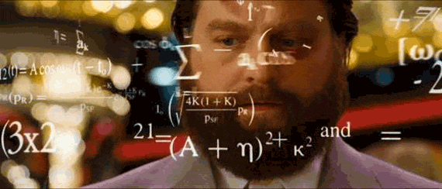
Tips for Success
Do not wait until the last minute.
Programming is a Language
Work Together (except during the test/exam):
Work Smart (effort doesn’t necessarily equal progress).
Time Management.
Know when (and how) to ask for help.
Notes:
Do not wait until the last minute, that goes for labs, and studying for midterms. Programming is a language, and you can’t memorize a language over night. It takes constant practice to start making it natural.
For those of you that know other languages, even in high school French or Spanish, understand that learning a programming language is the same. We’ll teach you how to use functions, and then conditional statements, and then how to use lists, but when we get to lists you can’t wipe you brain of everything you’ve just learned. Everything in programming builds on top of itself, just like a real language. If you learn present tense in French, and then move on to the chapter about past tense, you don’t get to forget everything you learned about present tense, because you need it all to be able to speak properly. Programming is the same.
The last point, know when and how to ask for help. You have Piazza to ask any question you want, but you’ll be able to get a much faster response and a much more useful response if you ask it properly. If somethings not working, let us know what error you’re getting (we’ll talk about errors on Friday this week). If you have a big piece of code, let us know what you are trying to do, what the goal of each block of code is. If you absolutely don’t know where to start, then show up to a tutorial, lab, extra help hours, or ask on Piazza. Don’t just stare at a blank python window for hours, you don’t have time for that in first year engineering, you’re already so busy, and we have so many available resources in this course for you to drop in and get help.

Slide 27
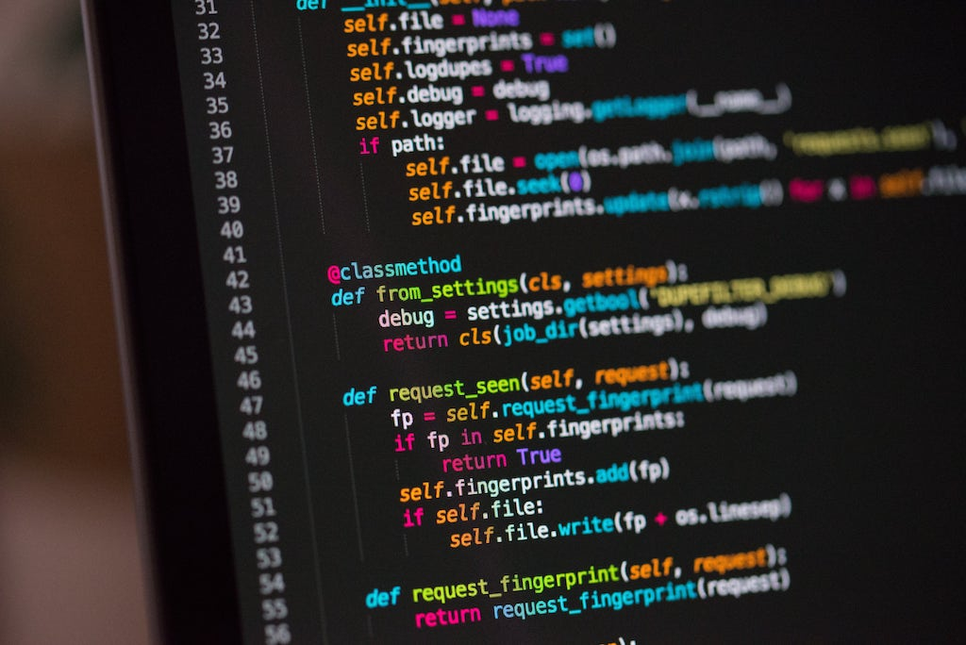
What is this course all about?
Learn the fundamentals of programming.
Programming as a tool used in engineering.
Engineering design through programming.
Notes:
Like I said before, programming really is a language. And the better you understand 1 programming language, the easier it will be to understand others. Just like how people that know a French and Spanish might be able to understand a bit of Italian. You start to recognize the basic chunks of language, and you can apply that to any new language you learn. So although we’re teaching you in Python, the course isn’t called “Fundamentals of Python” it’s Fundamentals of Comptuer Programming

Slide 28
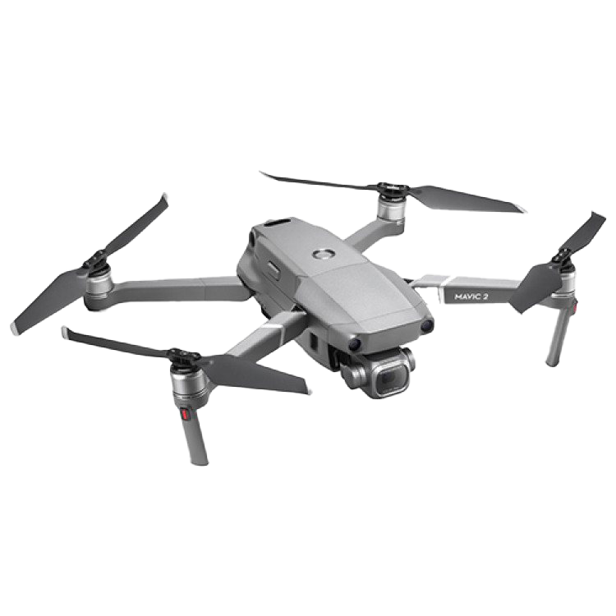

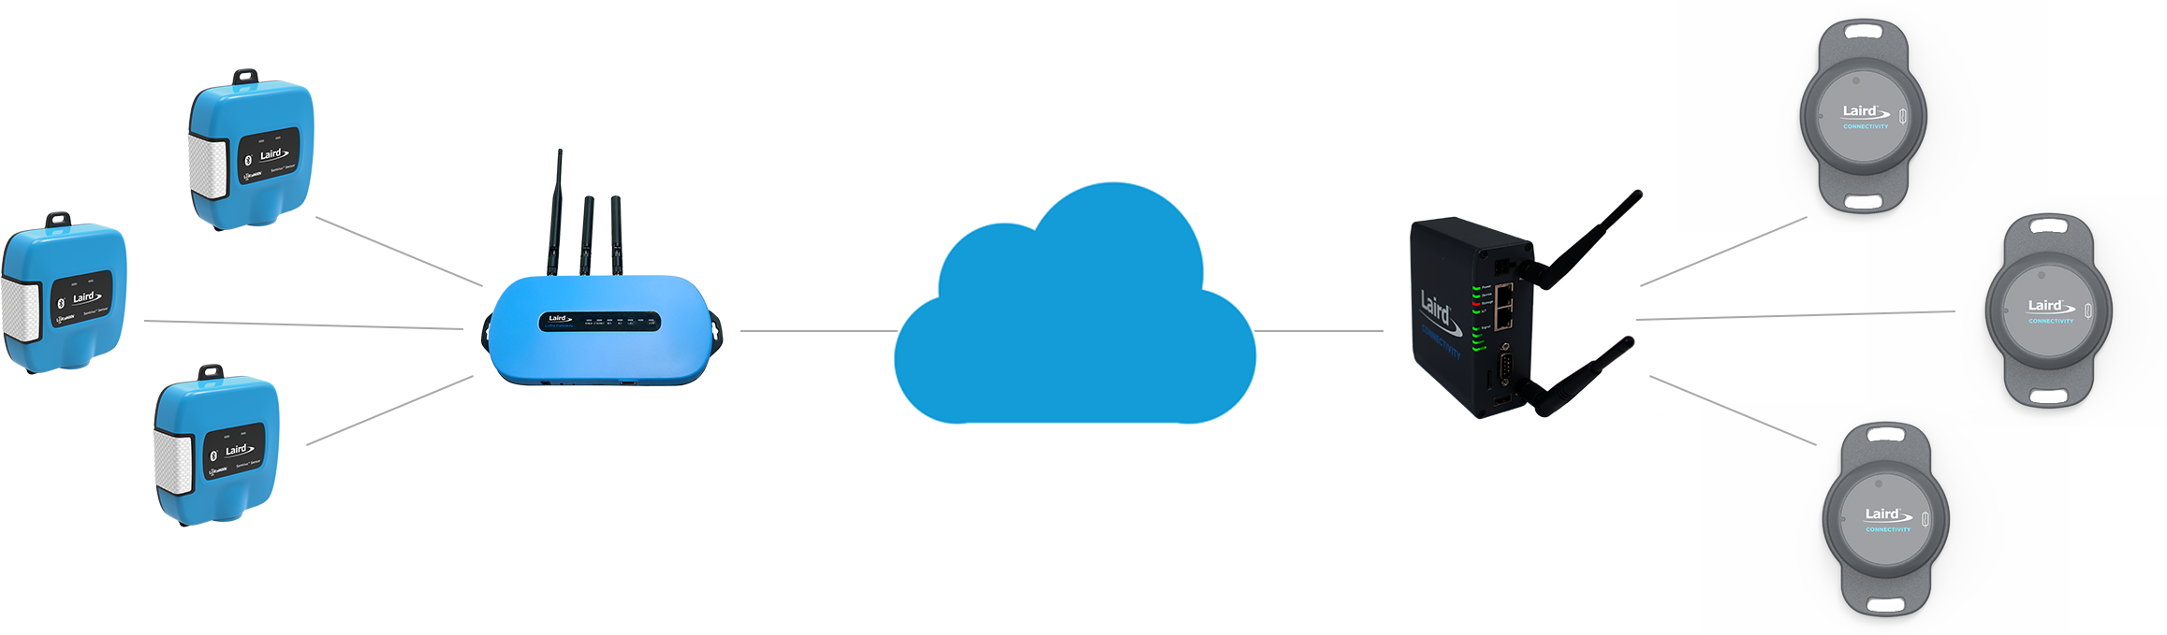

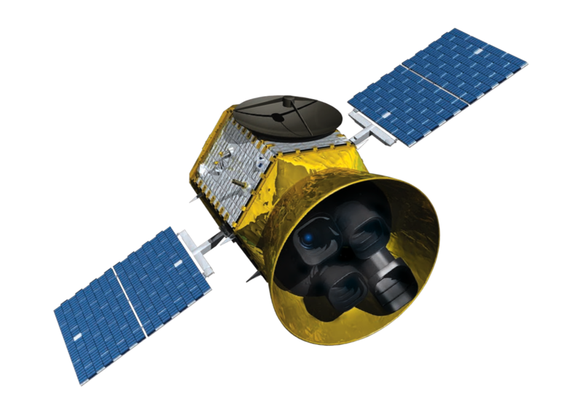
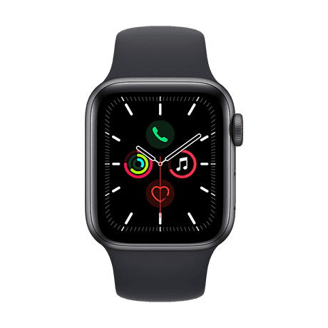
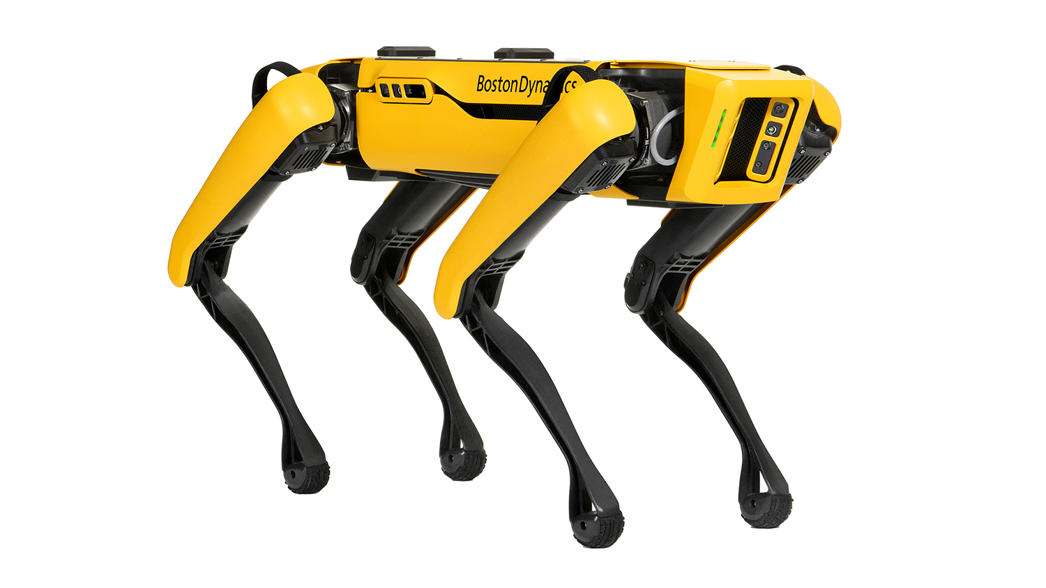

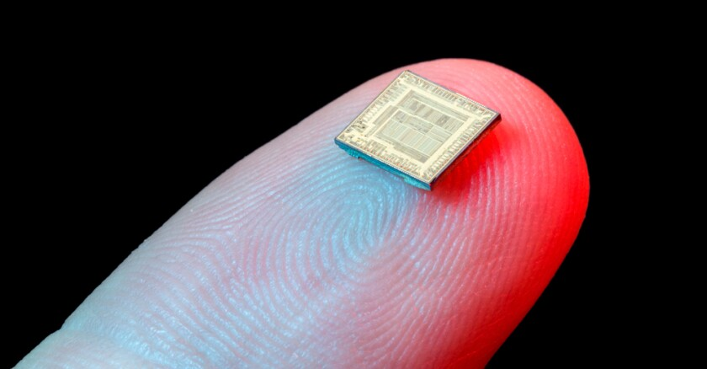
Why Programming?
Notes:
Everything COOL in the world, comes from programming.

Slide 29

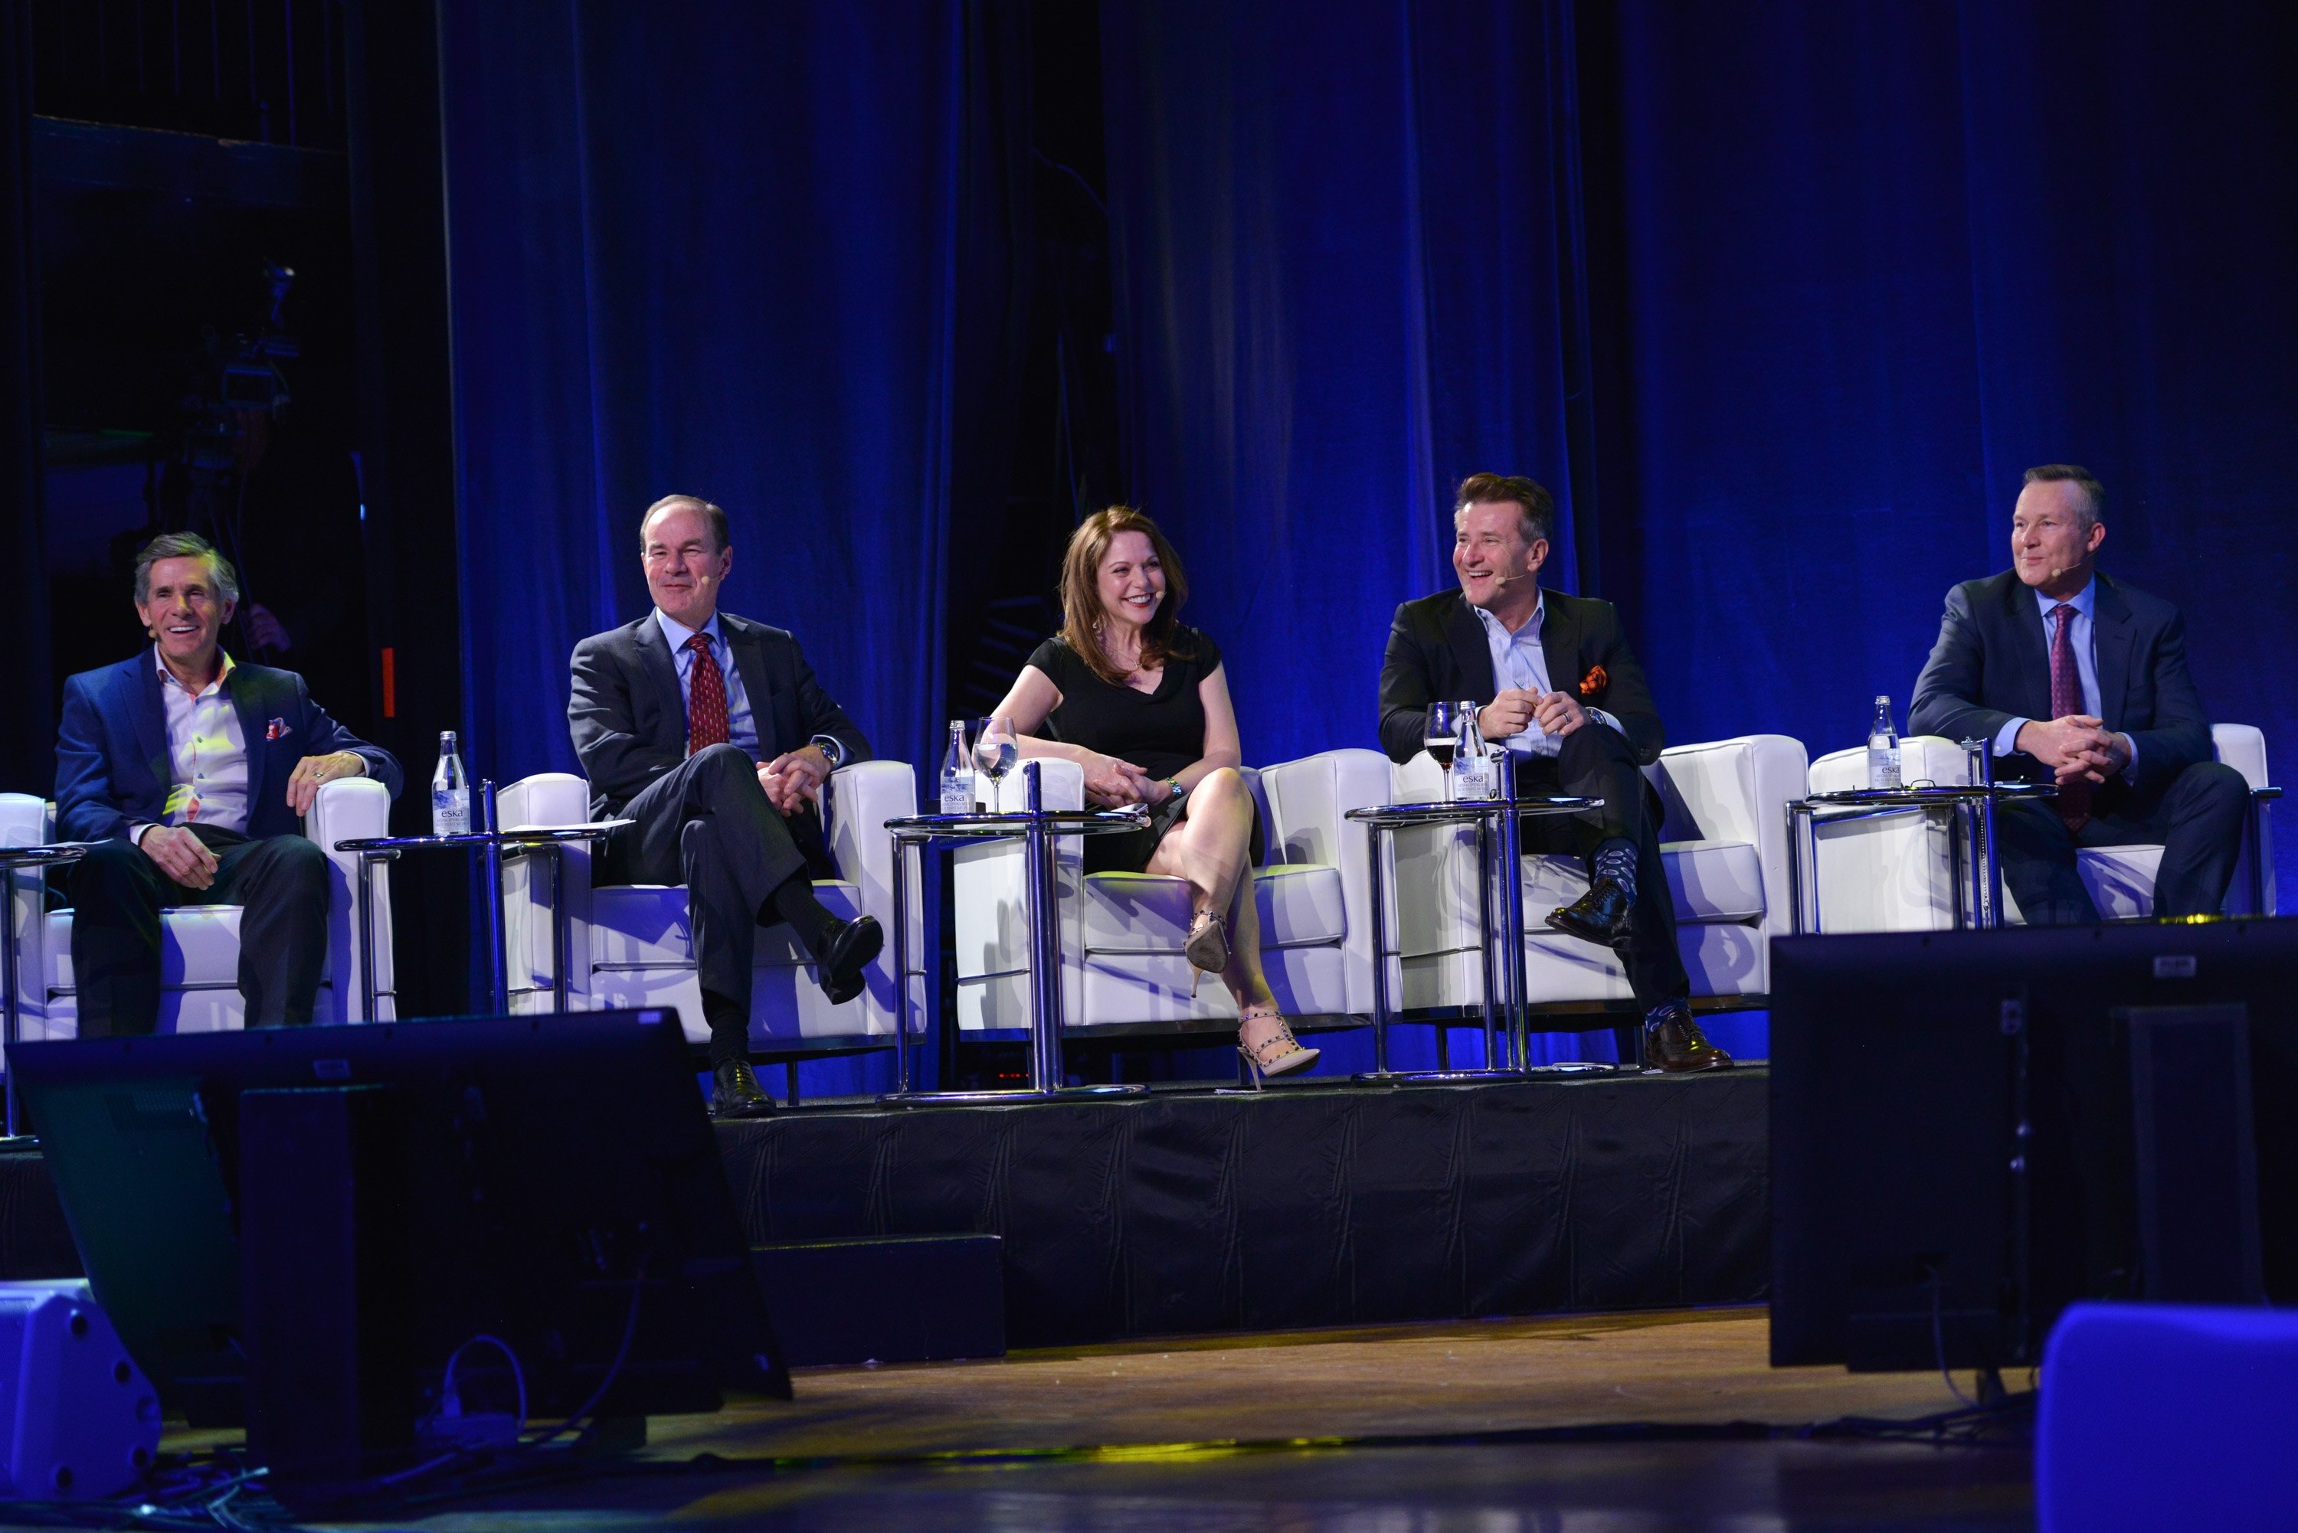
Why Programming?
Computers are everywhere:
Learn to interact with them.
Simplifies our jobs.
Entrepreneurial opportunities ($$$).
Necessary for engineering jobs.
Research and development.
Because it’s fun!
$1,000,000 Investment.
Owner of McEwen Mining Inc.
President of Cisco Systems Canada
COO of Goldcorp
CEO of Franco-Nevada Corporation
SHARK on ABC’s Shark Tank

Slide 30
What is Programming?
A way of telling a computer what to do.
A computer can’t infer (…yet).
Need to tell a computer every single step it needs to do in a language it can understand.
How would you request an egg for breakfast to a chef and to a computer/robot?
To a Chef
Sunny-side up, please!
To a Computer
“Turn on stove”
“Take out pan”
“Take one egg out of fridge”
“Crack egg”
“Pour egg into pan”
“Wait 5 minutes”

Slide 31
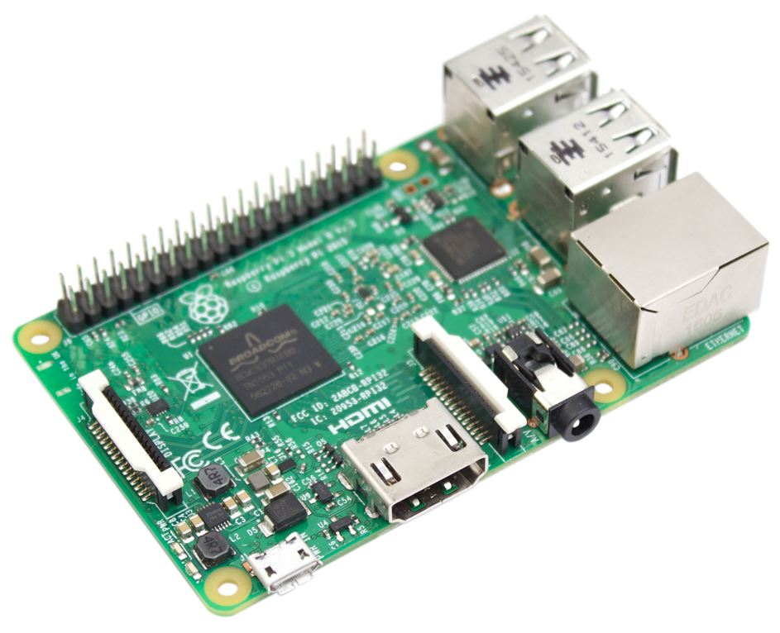
Programmer
English
How to Program a Computer.
Pseudocode
Programing Language
Compiler
Assembly Code
Assembler
Machine Code
Hardware
Notes:
We’ll talk a little bit more about assembly code vs machine code next lexture, but it’s really not important for the sake of this course.
There’s a reason we are teaching in Python

Slide 32
Why Python?
High-level language making it more like a readable, human language than other low-level languages.
Simple and clear syntax.
Large open-source community.
Used by Google, Firefox, Dropbox, Youtube, Instagram, Yelp, NASA, CIA, etc.
The Artificial Intelligence (AI) community overwhelmingly uses Python.

Slide 33


Why Python?
Lower-Level
High-level language making it more like a readable, human language than other low-level languages.
Simple and clear syntax.
Large open-source community.
Used by Google, Firefox, Dropbox, Youtube, Instagram, Yelp, NASA, CIA, etc.
The Artificial Intelligence (AI) community overwhelmingly uses Python.
public class HelloWorld
{
public static void main(String[ ] args)
{
system.out.println(“Hello World!”);
}
}
Higher-Level
print(“Hello World!”)

Slide 34
Why Python?
Increasing Program Size
Matlab, SQL
C++, Java, Python
High-level language making it more like a readable, human language than other low-level languages.
Simple and clear syntax.
Large open-source community.
Used by Google, Firefox, Dropbox, Youtube, Instagram, Yelp, NASA, CIA, etc.
The Artificial Intelligence (AI) community overwhelmingly uses Python.
C, Fortran, Pascal
Assembly Code
Machine Code
Hardware
Increasing
Ease-of-Use

Slide 35
Why Python?
High-level language making it more like a readable, human language than other low-level languages.
Simple and clear syntax.
Large open-source community.
Used by Google, Firefox, Dropbox, Youtube, Instagram, Yelp, NASA, CIA, etc.
The Artificial Intelligence (AI) community overwhelmingly uses Python.
if x > 10:
print(“x is greater than 10”)
You don’t know Python.
Can you figure out what this code does?

Slide 36
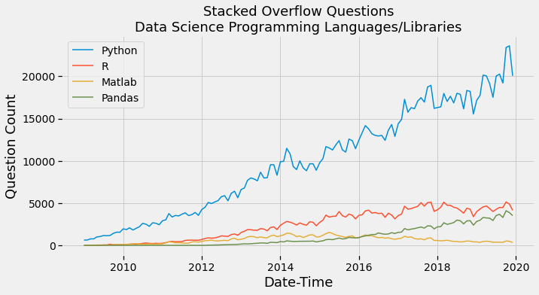
Why Python?
High-level language making it more like a readable, human language than other low-level languages.
Simple and clear syntax.
Large open-source community.
Used by Google, Firefox, Dropbox, Youtube, Instagram, Yelp, NASA, CIA, etc.
The Artificial Intelligence (AI) community overwhelmingly uses Python.

Slide 37









Why Python?
High-level language making it more like a readable, human language than other low-level languages.
Simple and clear syntax.
Large open-source community.
Used by Google, Firefox, Dropbox, Youtube, Instagram, Yelp, NASA, CIA, etc.
The Artificial Intelligence (AI) community overwhelmingly uses Python.

Slide 38










Why Python?
High-level language making it more like a readable, human language than other low-level languages.
Simple and clear syntax.
Large open-source community.
Used by Google, Firefox, Dropbox, Youtube, Instagram, Yelp, NASA, CIA, etc.
The Artificial Intelligence (AI) community overwhelmingly uses Python.

Slide 39

Why Engineers?
Ok, so we’ve explained why coding is important and why we’re learning to code in Python.
BUT, you’re all engineers, right?
Mechanical
Materials
Civil
Chemical
Mineral
Why do these kinds of engineers need to know how to code?

Slide 40

Mechanical Engineers
Design Airplanes
Micro Fluid Systems
Automotive Engines
Hydraulic Dams

Slide 41
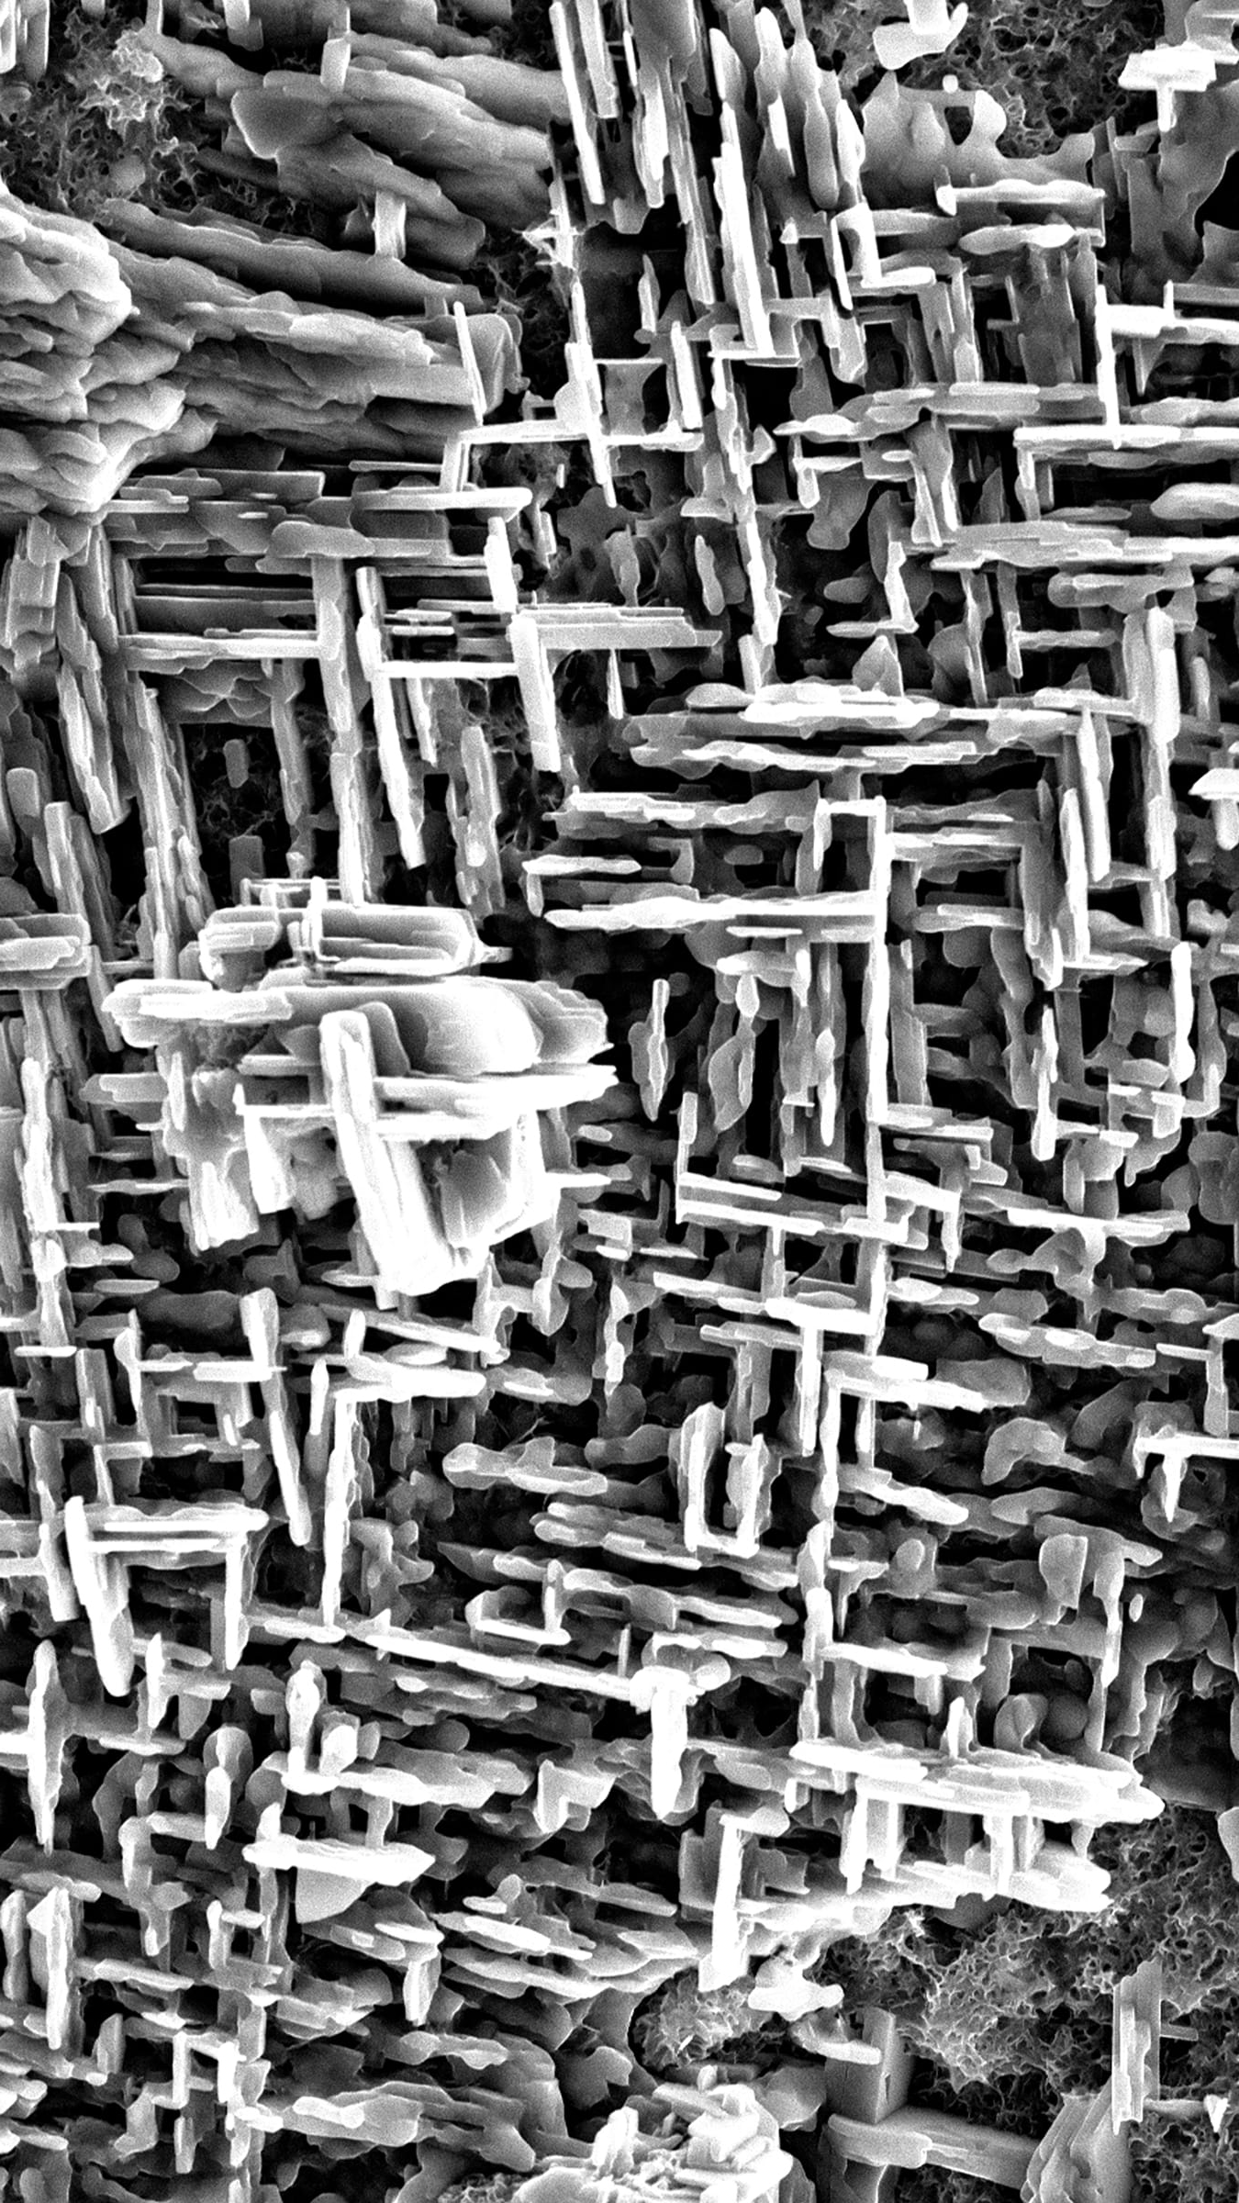
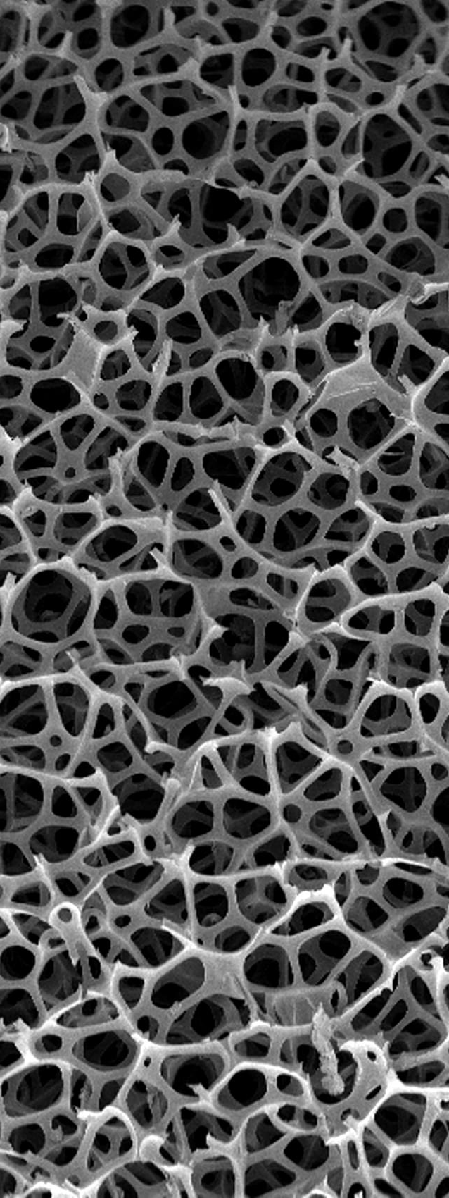
Materials Engineers
Biomaterials
Design of Materials
Manufacturing with Materials
Sustainable Materials Processing

Slide 42

Civil Engineers
Design Buildings
Test Concrete
Manage Water Supply System
Design Bridges

Slide 43


Chemical Engineers
Chemical Manufacturing Processes
Petroleum Extraction
Nanotechnology
Manufacturing Computer Components

Slide 44

Mineral Engineers
Mine Design
Mineral Processing
Mineral Exploration
Mining Finance
Mineral Extraction

Slide 45
Why Engineers?
Again, why do engineers need to know how to code?
In the 20th century, engineers didn’t need to know how to code.
In the 21th century, coding is an essential skill and any engineer without solid coding abilities will be at a major disadvantage.
Notes:
If you walk into an office, join a new project team, and you know how to program and others don’t – you instantly become more efficient. You might automate a lot of things people are doing over and over again. You might be abel to model something that someone else has to spend extra time prototyping and build to test to test to failure.
Any field you go into, understanding programming makes you instantly more valuable.

Slide 46
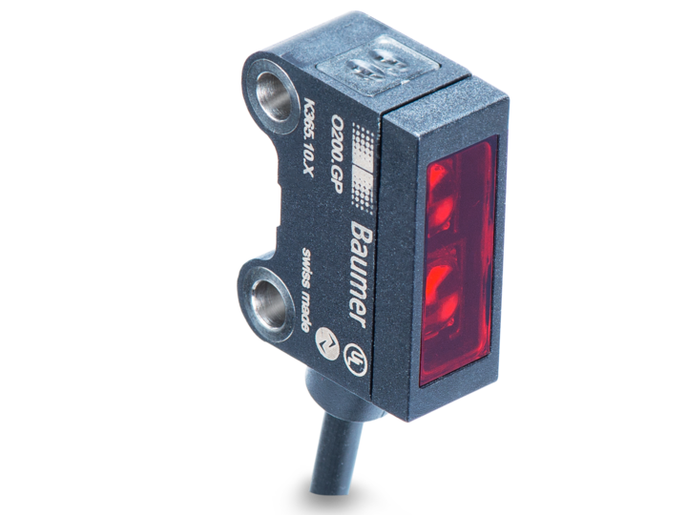


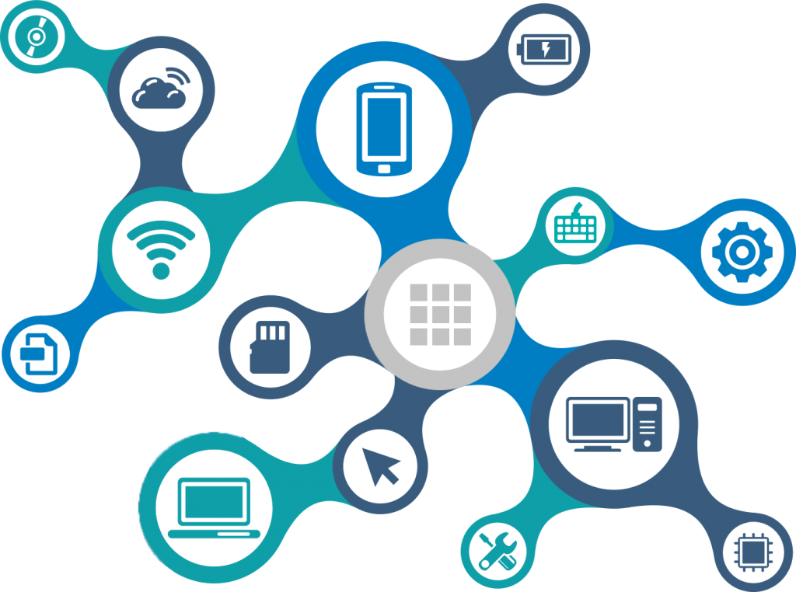

Why Engineers?
Five technology trends have changed the game for engineers.
The Cloud
Cheap Sensors
Artificial
Intelligence
Big Data
The Internet
Of Things
Notes:
The cloud – data can be accessible for anyone and anywhere.
Cheap sensors – instead of sensors costing thousands of dollars. The Texas instruments sensor that I used in that wheelchair vibration project which measured, environment temperature, object temperature, humidity, as well as acceleration in all three XYZ axes, magnetic field strength, and orientation - that only cost about 30 bucks. Think of the possibilities you could measure and create with all that data!
AI – like I showed you in that Google Glass example, or like Siri or Alexa on your phones, AI is changing the way we interact with our devices.
Big data – when we collect massive amounts of data, like using these cheap sensors, or health data from your fitbit or apple watch, we can use that data in machine learning algorithms to predict amazing things. We’re really just at the beginning of this, but I imagine in our lifetime, our biometric health data, collected from our smart watches, will be able to predict negative outcomes before they happen, just like how that calculus test at McMaster could predict students dropping out, and we’ll be able to change our lifestyle or a diet before they happen.
Internet of things is another state of the art concept, which really combines all these things I just talked about. Soon your smart home will know when your car pulls in the driveway so it can open the garage door, then it will know when you get in the door, can turn certain lights on depending on the time of day, and act on certain things, like calling your mom, or putting your phone on silent, depending on your habits.

Slide 47
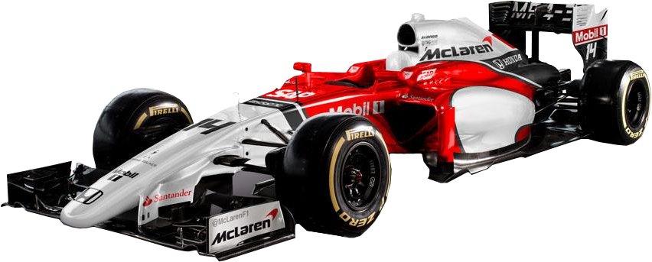
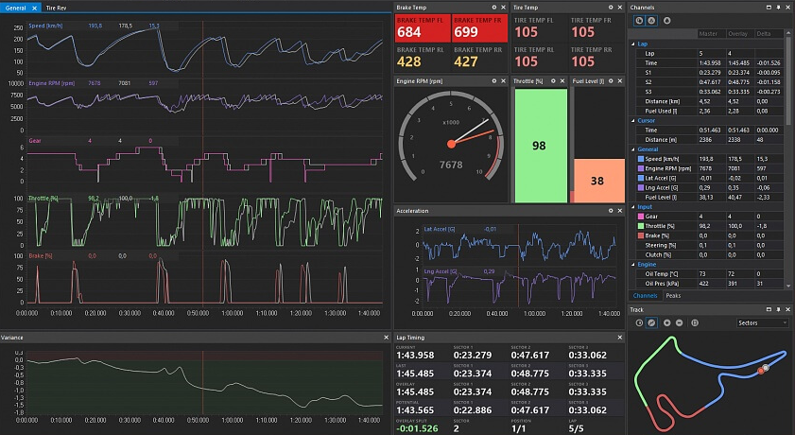
Mechanical Engineers
Realtime Diagnostics & Tuning

Slide 48
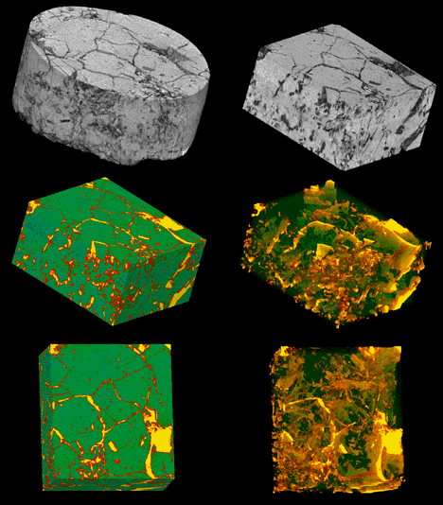
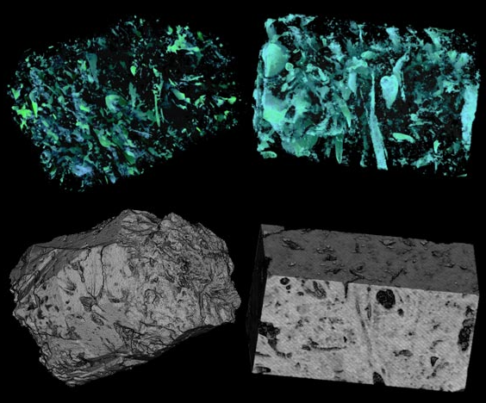
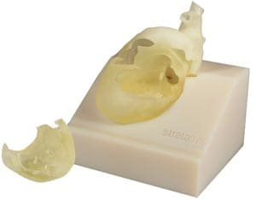
Materials Engineers
Digital Image Analysis of Material Microstructure

Slide 49


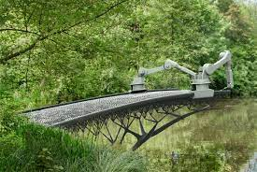
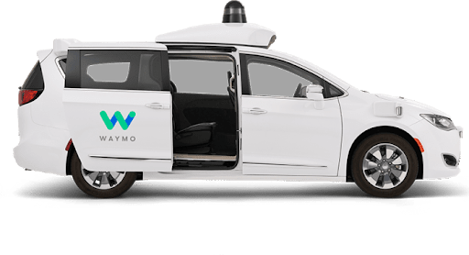
Civil Engineers
Urban Transportation Disrupted

Slide 50
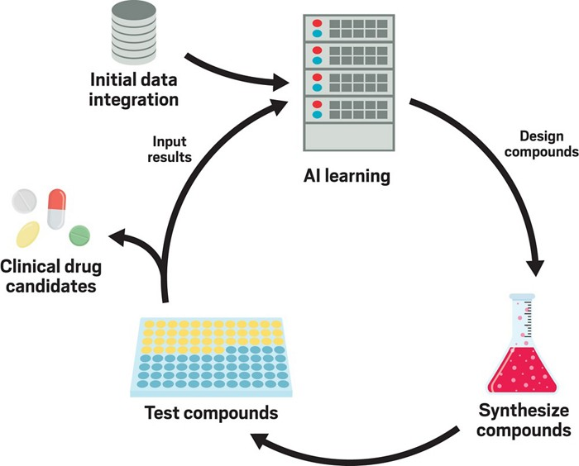
Chemical Engineers
Synthesizing new compounds

Slide 51

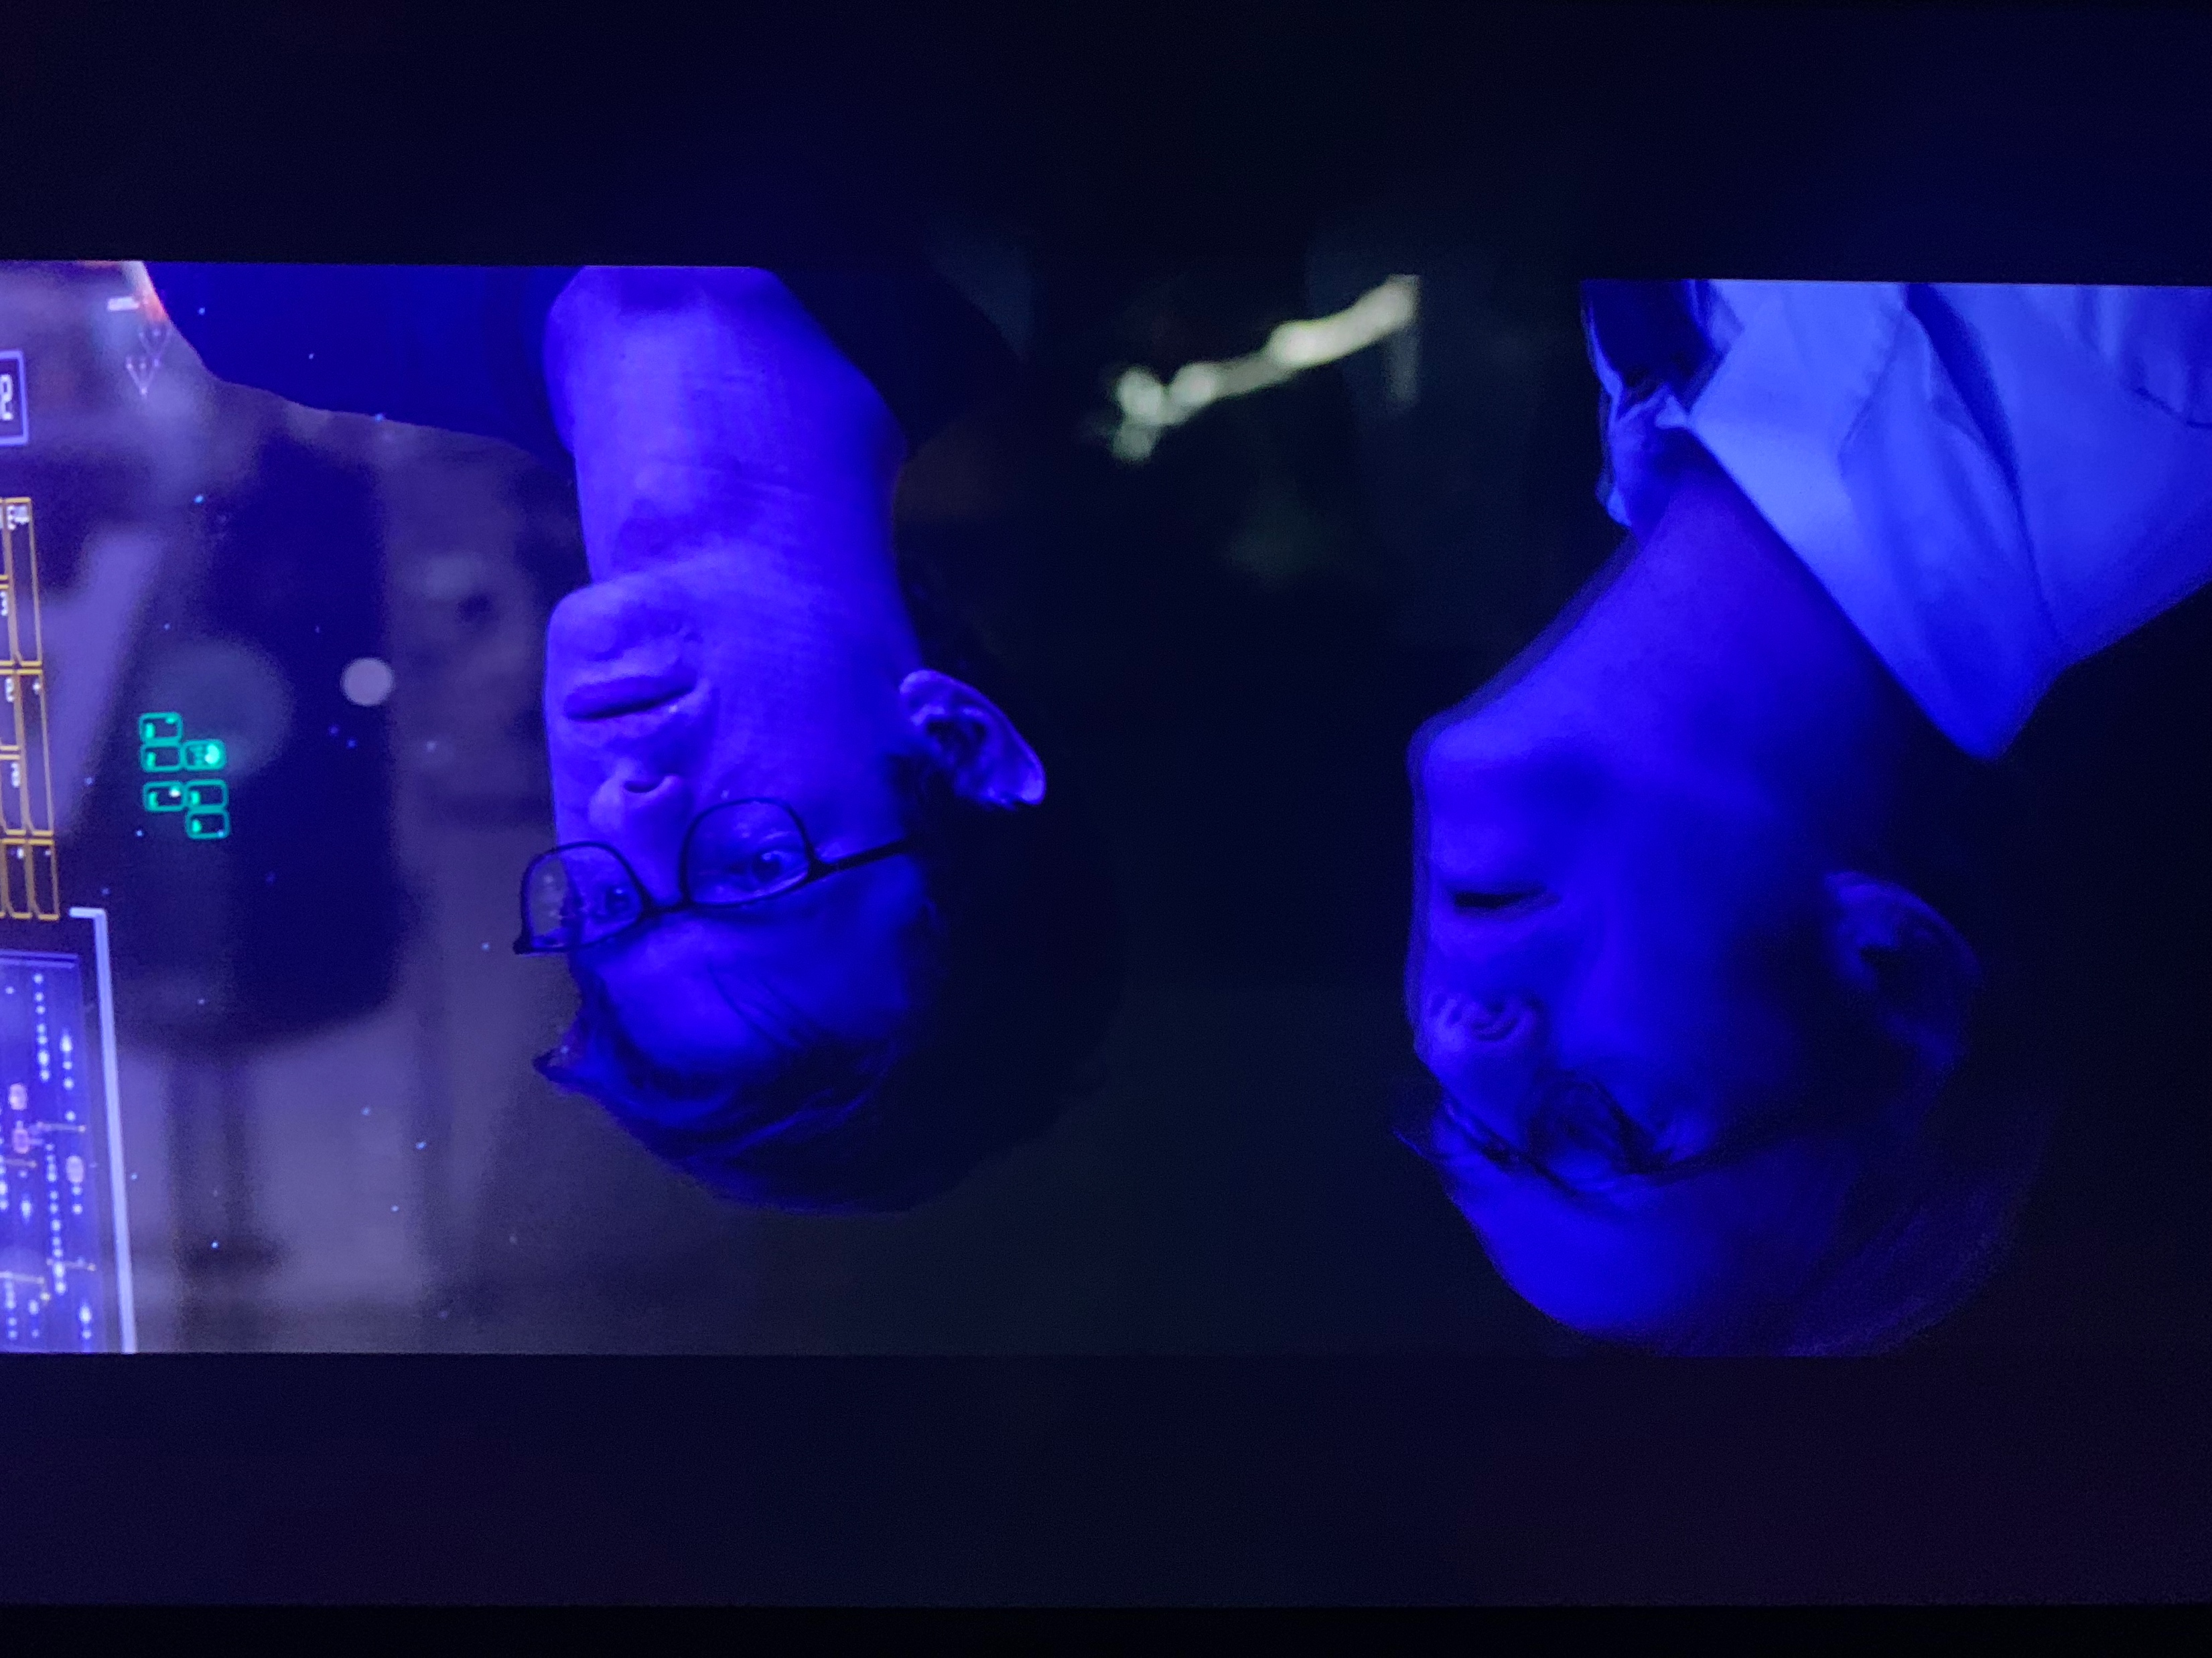
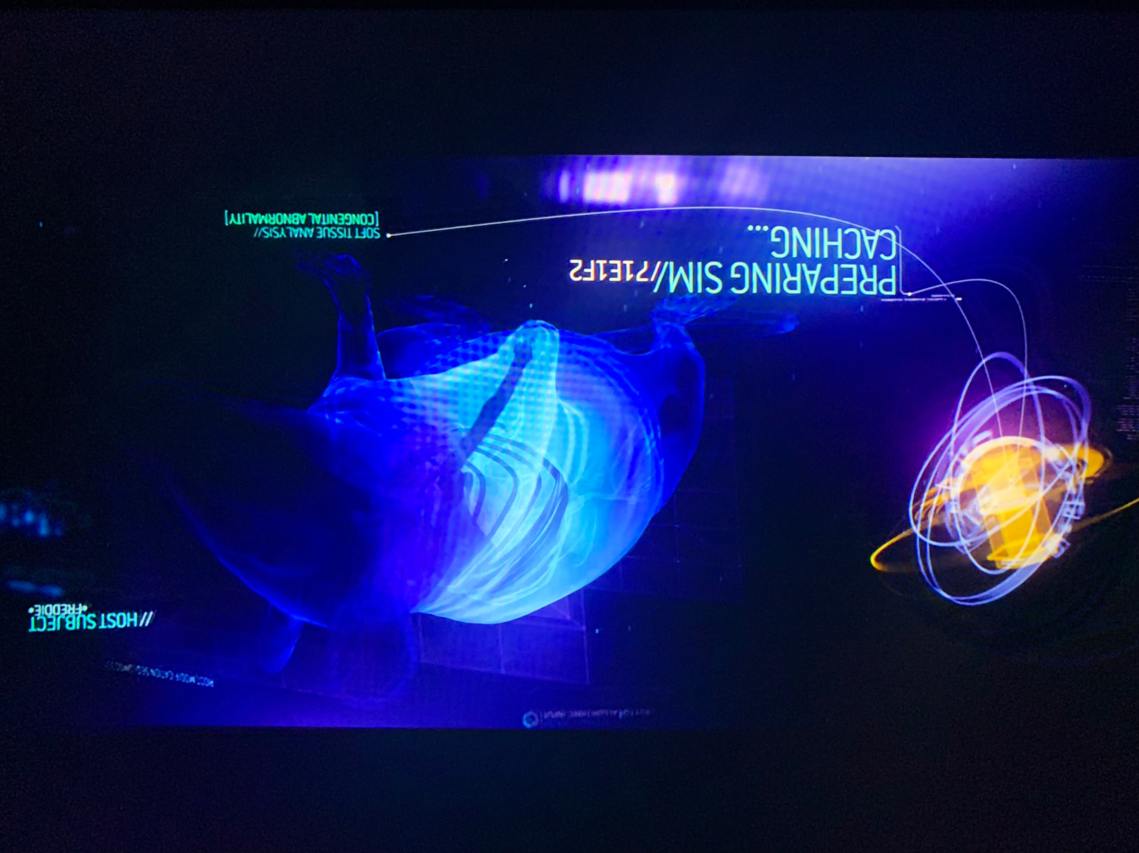
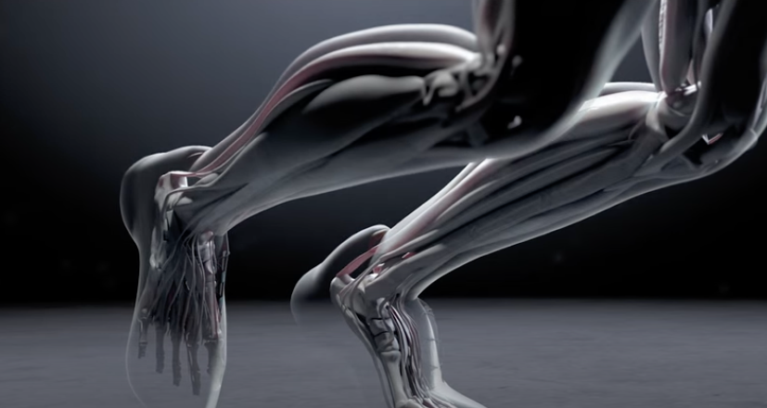
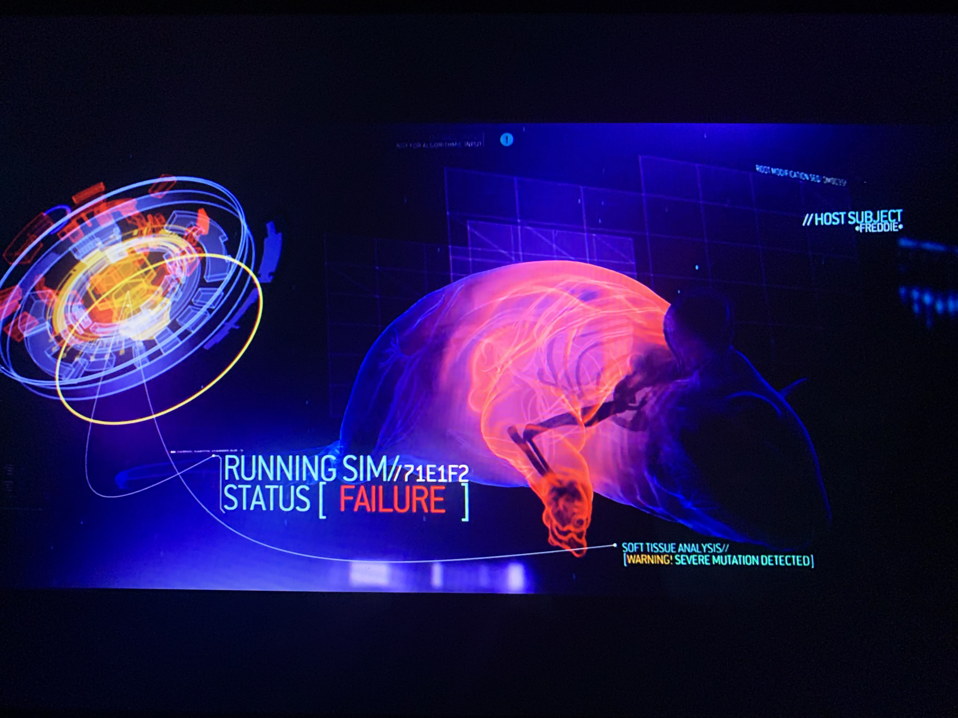
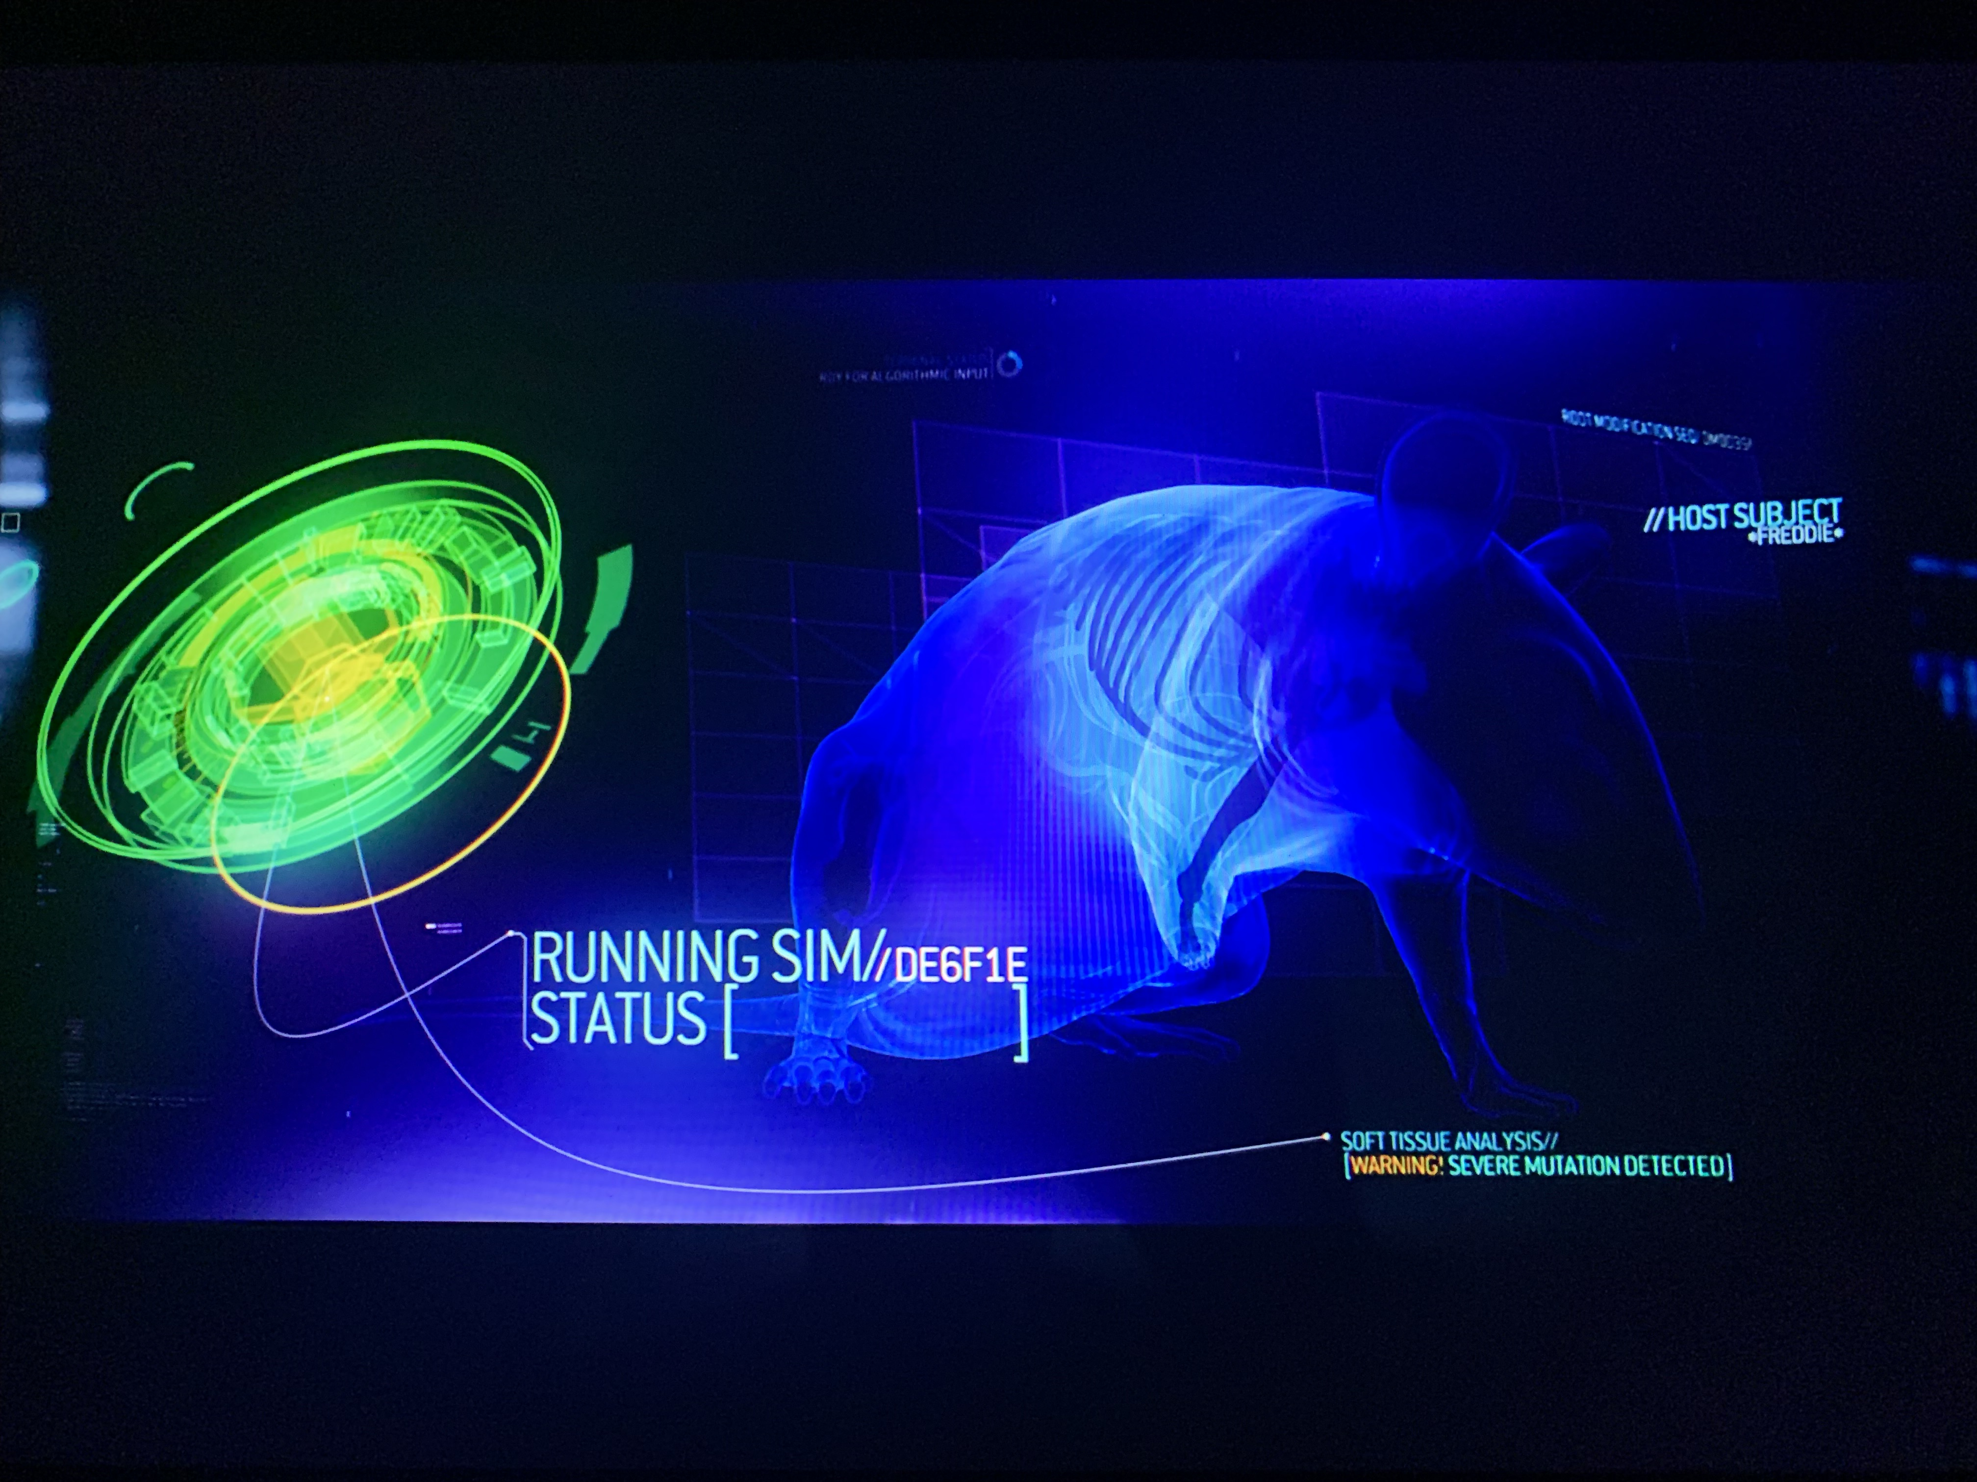
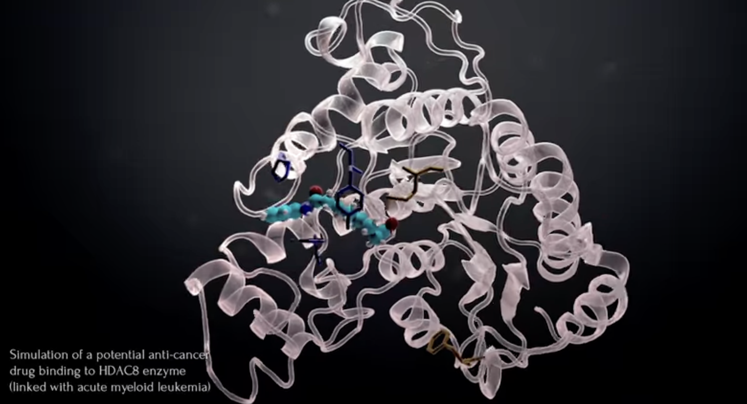
Sci-fi Inspiration
Notes:
Putting different genes into a simulated mouse so they can predict which will produce the correct outcome.
In real life, there’s orgnaizations like CompBioMed that are trying to simulate real human bodies, completely accurate simulations of a single individual. Imagine the power of being able to know if a drug would work before you take it. Imagine if you knew exactly what a vaccine would do before you took it. Imagine elite professional athletes that could see the outcome of specific workout routines, or diets, so they know which to to follow.

Slide 52
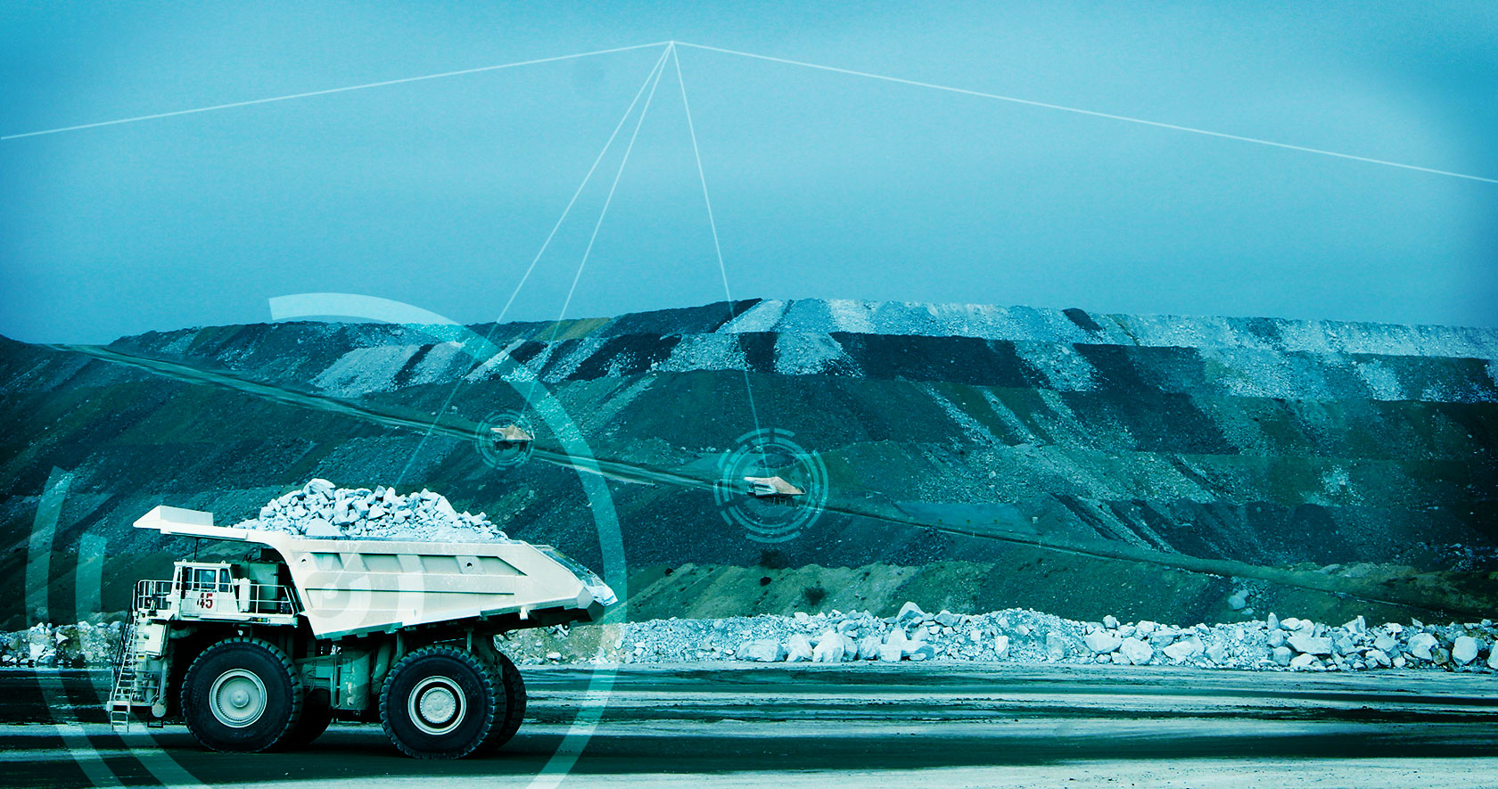


Mineral Engineers
Semi-Autonomous Mines

Slide 53
Programming Skills Are In Demand
According to the Developer Survey by StackOverflow, Python was one of the most in-demand technologies of 2018, 2019, 2020, and 2021.
As of 2021, it is ranked as the world’s 2nd most popular programming language among professional software developers as well as the first most wanted programming language.
Notes:
Programming skills are in demand, and Python is one of the sought after and used languages in the world.

Slide 54

One of the reasons for choosing Engineering!
Finally! A course that isn’t Chem, Bio, Physics, or Math
This (as well as your engineering design course) is what separates you from many other sciences
And makes you MUCH more valuable….

Slide 55
introduction.
Week 1 | Lecture 1 (1.1)

